Slide 1

INTRODUCTION
Roger C. Wiens
SuperCam Data Workshop
LPSC, The Woodlands, Texas, USA
Tuesday, March 11, 2025

Slide 2
Agenda
Topic | Presenter | Duration | Start Time
Introduction | Roger Wiens | 12 minutes | 5:00 pm
2. VISIR reflectance spectroscopy | Allison Zastrow | 12 minutes | 5:15
3. LIBS / elemental chemistry | Agnes Cousin | 12 minutes | 5:30
4. Time-resolved Raman / luminescence | Ann Ollila | 12 minutes | 5:45
5. Imaging (RMI) | Stéphane Le Mouélic | 12 minutes | 6:00
6. Acoustics (microphone) | Sylvestre Maurice / Baptiste C | 12 minutes | 6:15
7. Group / question time | All | ~15 minutes | 6:30

Slide 3
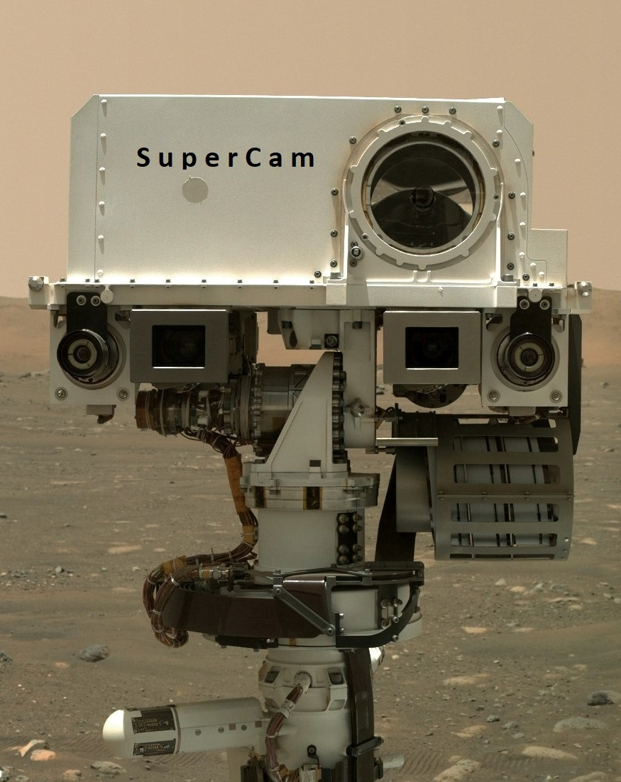
INTRODUCTION OUTLINE
Purpose & agenda
SuperCam instrument in a nutshell
Where to find data, PDS nomenclature
Formats of data files
Fields of view, overlap
Operations, order of ops, nomenclature
Other activities
Mission
Papers
Collaborations

Slide 4
Purpose
To inform scientists how to access SuperCam data and use it
To inform about past and present work; inspire ideas for new research
To foster greater use and collaboration with SuperCam data. Collaboration can be with SuperCam team members (help learn to use the data) or among other researchers.

Slide 5

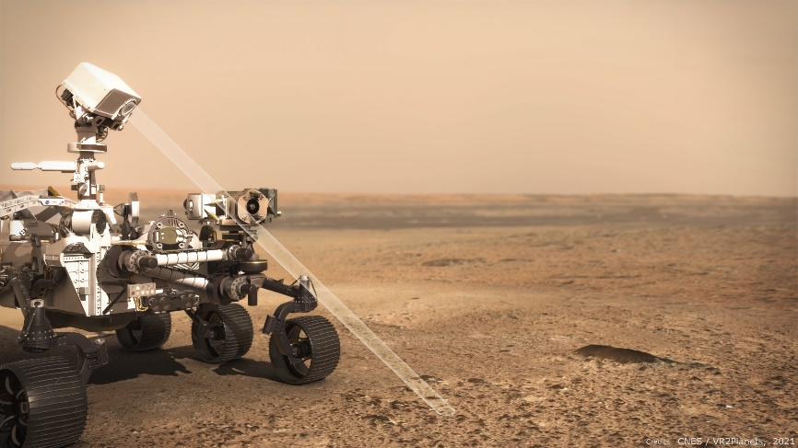
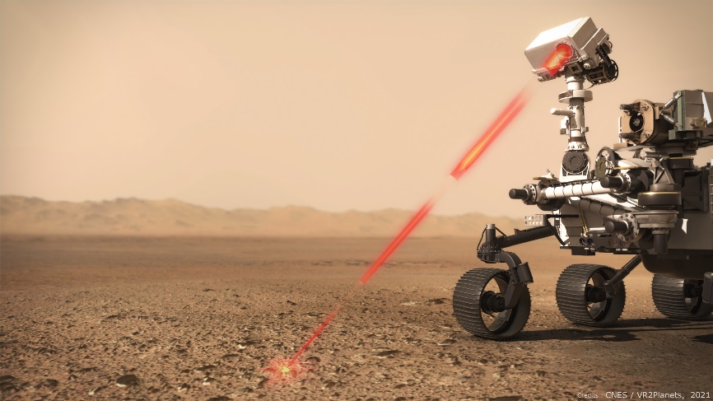

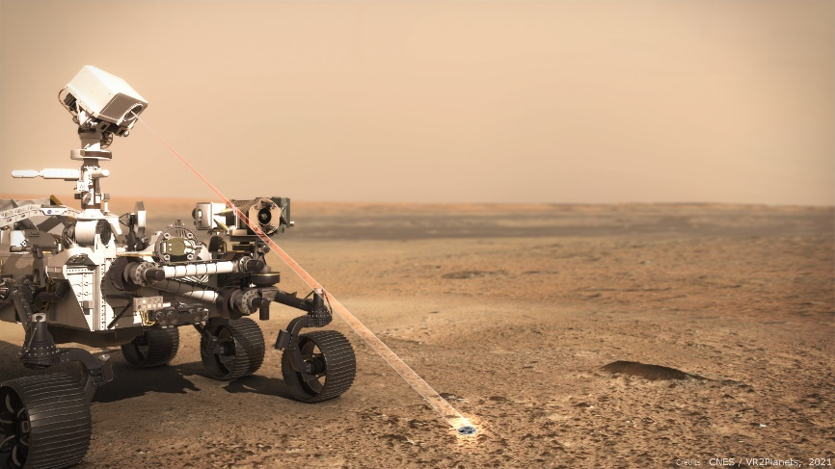
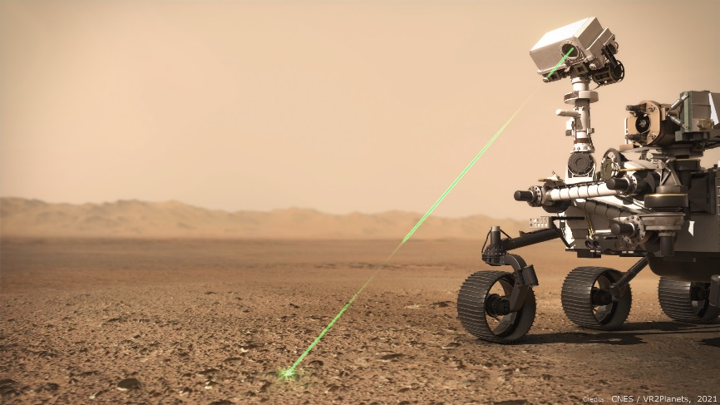
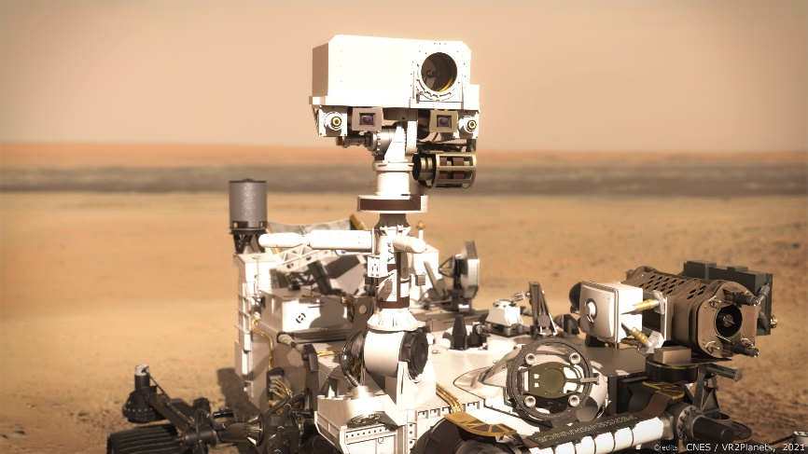
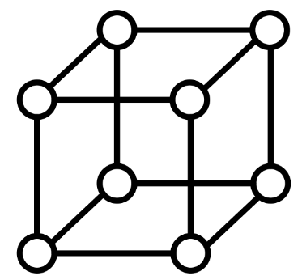


LIBS
Elemental Chemistry
Imaging
40 µrad
Highest remote resolution
Nearly identical to ChemCam
SuperCam
VIS-IR
Minerals
Raman
Minerals & Organics
MIC
First near IR from surface of Mars
Includes luminescence
Rock hardness
Sound speed
Wind
In situ,
Characterize habitability
Aid search for organics
Samples,
Find the most relevant to collect
Document their geological setting
Figure by Sylvestre Maurice

Slide 6
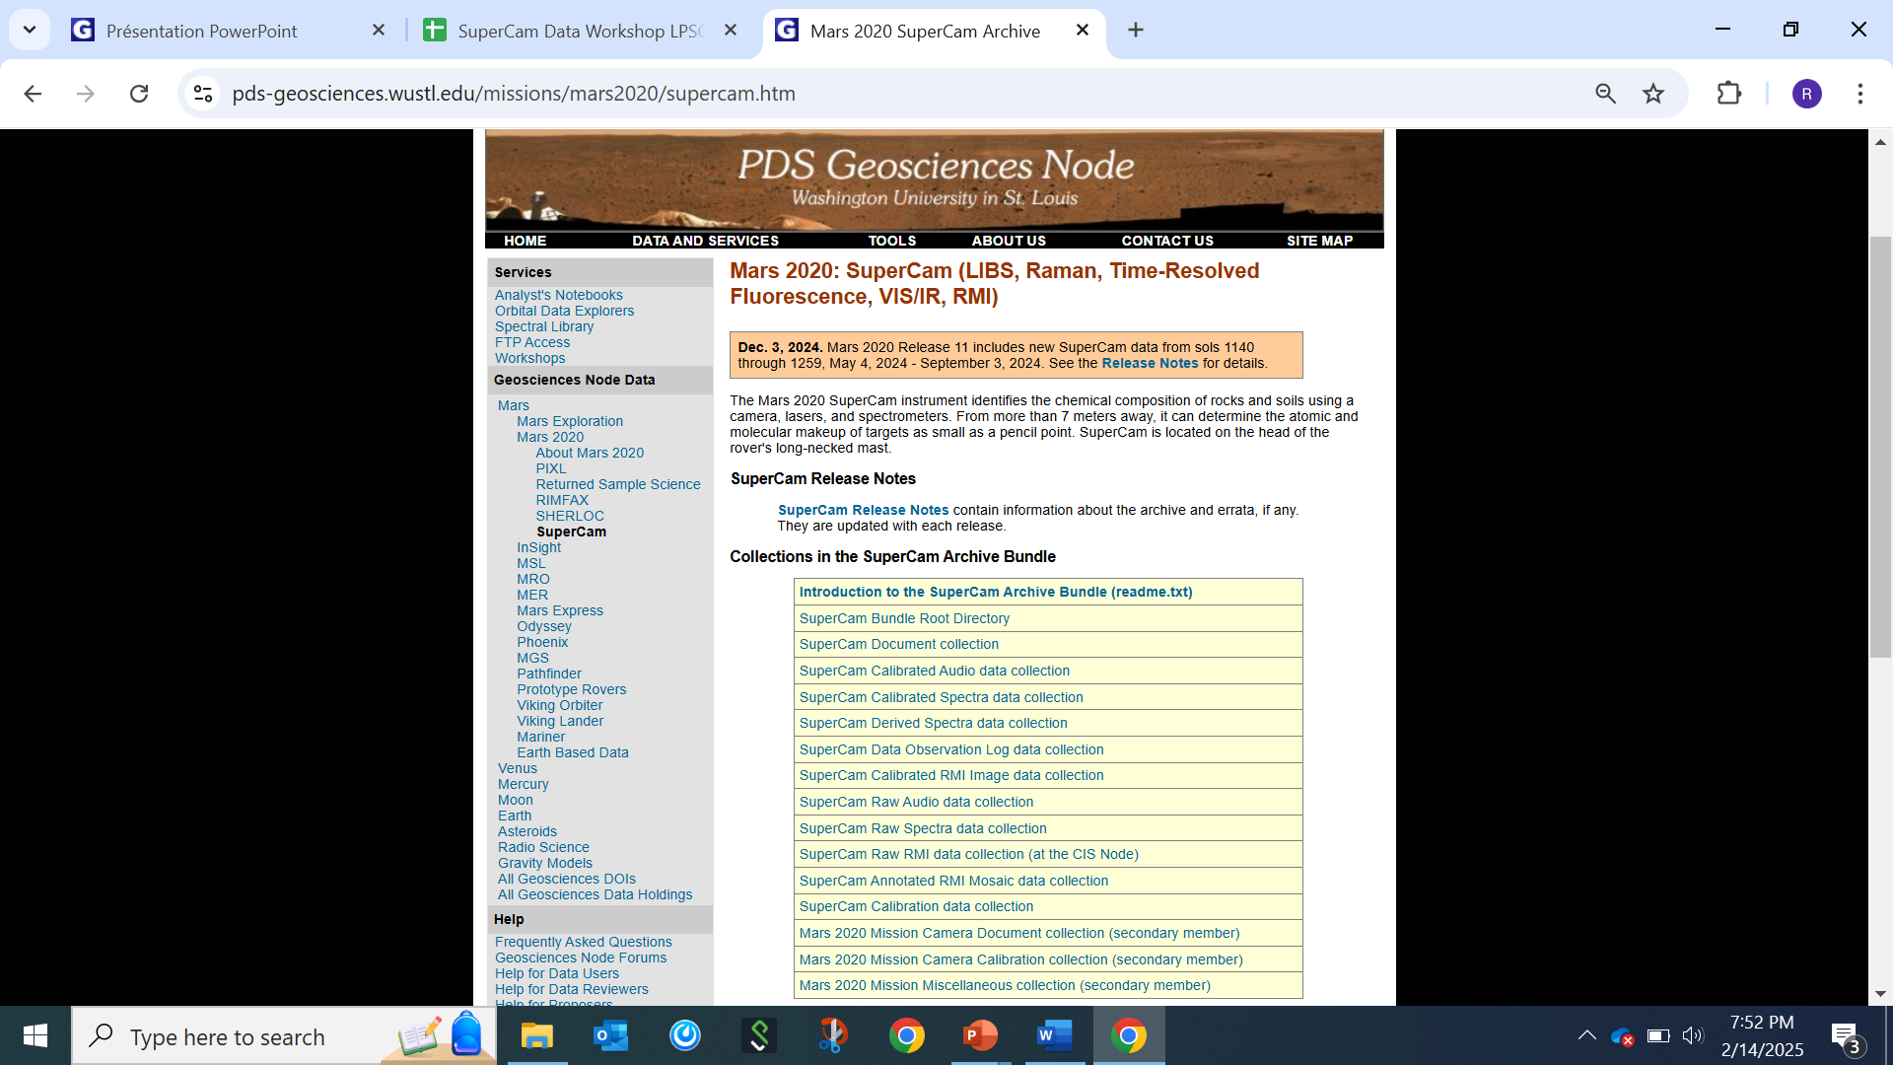
Documentation
Calibration data
Raw Spectra
Calibrated Spectra
Derived Products
--Elemental compositions
--Raman molecular IDs
RMI images
RMI mosaics
Other:
Obs Files (details on all data)
Analyst’s Notebook

Slide 7
Raster, example
This example does not include VISIR, normally done on each point.
AF
AF
3 RMI
5 LIBS
5 Microphone
3 RAMAN
2 AF
AF = autofocus
P. Pilleri

Slide 8
How is a raster organized into files?
This example does not include VISIR, normally done on each point. VIS & IR are separate files
One “science collect” → One FITS file
AF 1
AF
RMI
LIBS
MIC
RAMAN
RMI 1
LIBS Header
=
LIBS 1
Point 1
Active LIBS Spectra
MIC 1
Dark LIBS spectra
RAMAN 1
SOH (temperature, focus position…)
LIBS
MIC
List of LIBS commands
Point 2
LIBS 2
=
MIC 2
Containing everything associated with the
observation (spectra, SOH, parameters, …)
LIBS
MIC
RAMAN
RMI
LIBS 3
MIC 3
Point 3
=
AF = autofocus
RAMAN 3
RMI 3
…
…
P. Pilleri

Slide 9
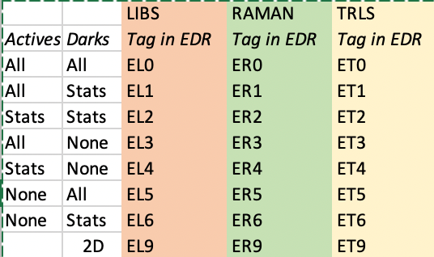
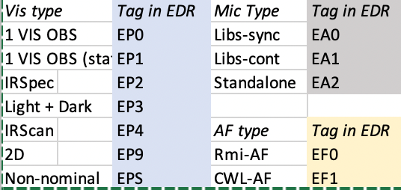
Prefix
SolN
SCLOCK_SCLOCK Fraction
Technique
Type
Site
Drive
Point
Number
SeqID
Producer
EDR (non-img):
LS__0113_0668703365_088EL1__0010000SCAM01113_000_LUJ01.FITS
Compression
Version
EDR (imaging):
LRE_0299_0625326171_403ECM_N0010044SCAM15282_0000LUJ01
Targetname
CDR
SCAM_0117_0067732593_000_CL0_scam01117_Mendocino____________02P01
Mosaics
Annotation:
Libs, Raman/VIS, Irs
Resolution
Targetname
ASCAM_SOL0117_scam01117_MOS_LR08_AFT_RGB_***_Mendocino____________02P01
AFTer/BEFore/FUSioned
Stretch
Technique types codes
P. Pilleri

Slide 10
Code for extracting the data are in the backup slides

Slide 11
EDR files structure
Filename examples
LS__SOLN_0123456789_012EF0__0010000scam12345_____01J00.fits
LRE_SOLN_0123456789_012ECM_N0010000scam12345_S001LUJ00.fits
 |  | Experiment Data Record – EDR
 | Activity | LIBS | RAMAN | TRLS | VIS | IRS | Micro | RMI | RMI JPG | Autofocus | SOH* | 2D
 | Activity tag | EL[0-6] | ER[0-6] | ET[0-6] | EP[0,1,3] | EP2 | EA[0-2] | LRE*EC* | LRF*EJP | EA[0-2] | Various | E[L,R,T,P]S
HDU # | Relevant HDU section | Content
0 | Header | Generic Header, Activity keywords (including basic temperature, focus position, ...)
1 | Data | ODL Label
2 | Data | Timeline (I-cmds and their arguments)
3 | Data | MU SOH
4 | Data | BU SOH
5 | Data | Laser Data | Laser Data | Laser Data |  | Spectel SOH | Laser Data | Red | Red | AF results parameters |  | Laser Data
6 | Data | Darks Before | Darks Before | Darks Before | VIS spectra | Darks | Time series | Green 1 | Green | AF Curve |  | UV Dark
7 | Data | Actives | Actives | Actives | VIS darks | Spectra |  | Green 2 | Blue |  |  | VIO Dark
8 | Data | Darks After | Darks After | Darks After |  | Spectra SOH |  | Blue |  |  |  | G/O/R Dark
9 | Data |  |  |  |  |  |  |  |  |  |  | UV Actives
10 | Data |  |  |  |  |  |  |  |  |  |  | VIO Actives
11 | Data |  |  |  |  |  |  |  |  |  |  | G/O/R Actives
P. Pilleri

Slide 12
CDR files structure
Filename example
CDR_SOLN_0123456789_CF0_scam12345_TargetNameCharacters_01J00.FITS
 |  | Science product (Clean Data Record – CDR)
 | Activity | LIBS | RAMAN | TRLS | VIS | IRSpec | Micro | RMI | AF
 | Activity tag | CL[0-3] | CR[0-3] | CT[0-6] | CP3 | CP2 | CA[0-2] | CI | CA[0-1]
HDU # | HDU section | Content
Primary | Header | Generic Header, Status Flags, Activity keywords, Data Processing Keywords
1 | Data | ODL Label
2 | Data | Timeline (I-cmds and arguments)
3 | Data | MU SOH
4 | Data | BU SOH
5 | Data | Laser Data | Laser Data | Laser Data |  | IRS Spectel SOH | Laser Data | Red | AF result table
6 | Data | Shot-to-shot spectra | Shot-to-shot spectra | Delay Spectra | Shot-to-shot spectra | Spectra | Time series | Green | Autofocus Curve
7 | Data | Statistics spectra | Statistics spectra | Statistics spectra | Statistics spectra | Wavelength | Saturation Mask | Blue | Motor position
8 | Data | Wavelength | Wavelength | Wavelength | Wavelength | IRS Acquisition SOH
9 | Data | Saturation | Saturation | Saturation | Saturation | Saturation
P. Pilleri

Slide 13
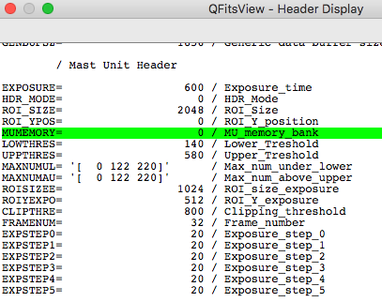
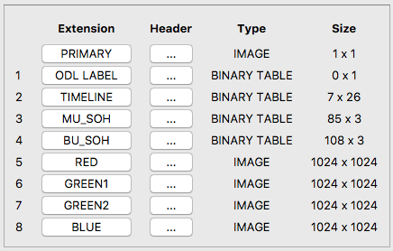
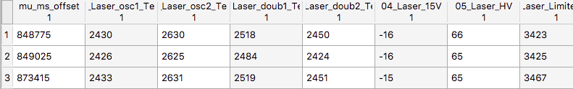
Example of FITS File Contents by HDU
Primary Header
Example for RMI
DATA
P. Pilleri

Slide 14
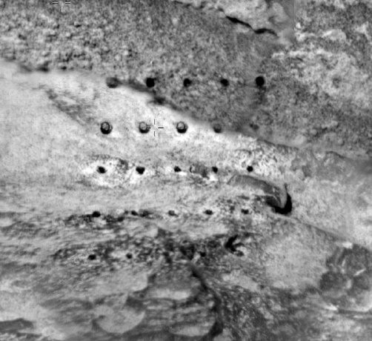
Nomenclature
Shot = single laser pulse; the plasma signal is recorded with a spectrum from
each shot
Observation point = location; the place where the laser fired at a single point.
Almost all location analyses consist of 30 LIBS spectra
Raster = series of points observed on a single target. Usually 1x5, 2x5, 1x10, 3x3
“30 shots per point (LIBS, rock),” “up to 10 points per raster”
LIBS depth profile: > 50 laser shots in the same location, to investigate compositional variations at greater depths
LIBS or Raman “Dark” = non-laser background exposure of the same duration used for the active observation
Sequence = single set of commands that includes a raster, before & after RMI images, and darks. Each SuperCam sequence has SCAM + (single digit) + (last 3 digits of sol number)
Target = region of bedrock, soil, or float rock where the raster is placed. Each target has a name.
AEGIS = onboard autonomous target selection software; picks targets without ground in the loop
SCCT = SuperCam Calibration Targets, on back of rover (see publications)
AF = Autofocus, done occasionally throughout the raster

Slide 15
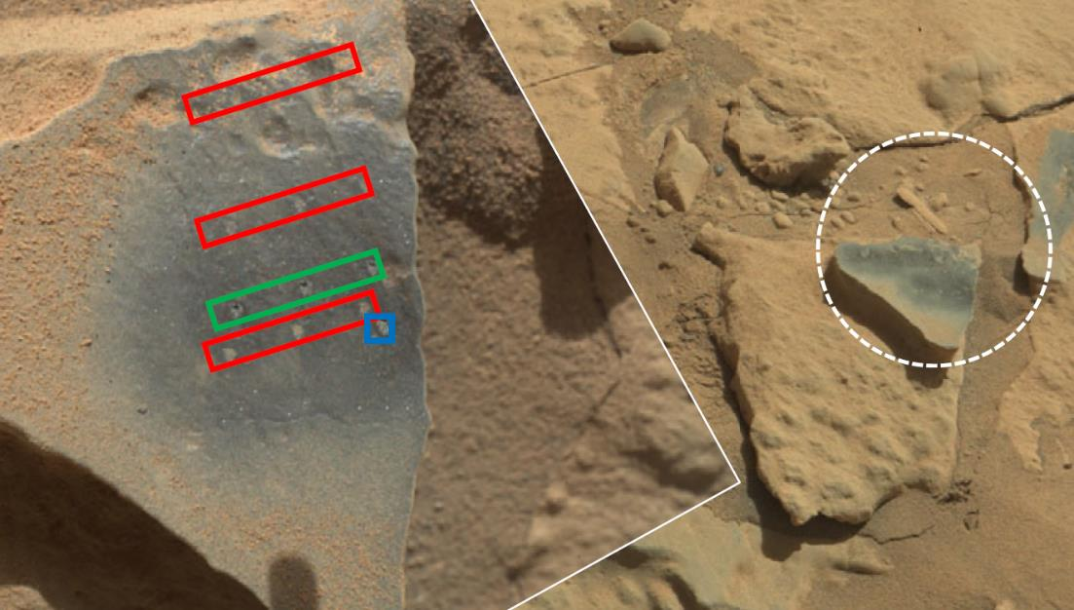
Dust Removal By LIBS Enables the Other Techniques
ChemCam target Stephan
Circle shows RMI field of view
(~6 cm at this distance)
IR field of view
Maurice et al. 2021
Notes:
This rock did not show up dark at all before the LIBS removed the dust!
The image at right was taken after one more LIBS raster, moving more dust out of the way

Slide 16
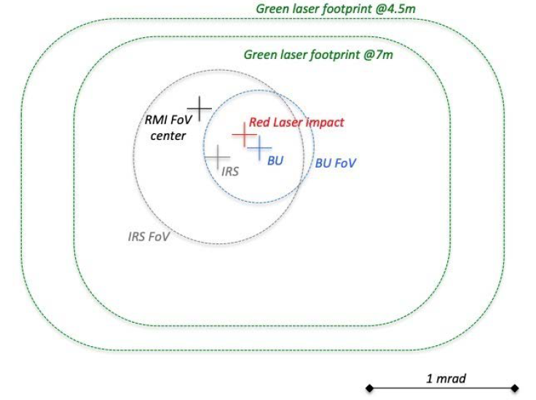
Alignment of Techniques / Order of Techniques
LIBS footprint based on laser focus, not spectro FoV; 170-450 µm @ 2-7 m;
Smaller than ChemCam
Order of Techniques
For rock surfaces
RMI image
LIBS (clears dust)
VISIR + Raman
RMI image
For soils, LIBS is done after VISIR & Raman
VIS & Raman FoV
LIBS pit is much smaller than Raman or VISIR FoV; does not affect them
Maurice et al. 2021

Slide 17
Other Activities
SuperCam makes regular observations of the sky for atmospheric absorption and opacity
  Data available as EDRs (some CDRs are generated, but don’t use them for sky observations)
  Talk to Tim McConnochie or Franck Montmessin
SuperCam has made observations to detect auroras on Mars. See presentations by Elise Knutsen.
SuperCam has made observations of various rover hardware; the observations consist of imaging, a few rare spectra, and recordings.
SuperCam has used L-shaped (3-point) rasters to mark the top of sample cores

Slide 18
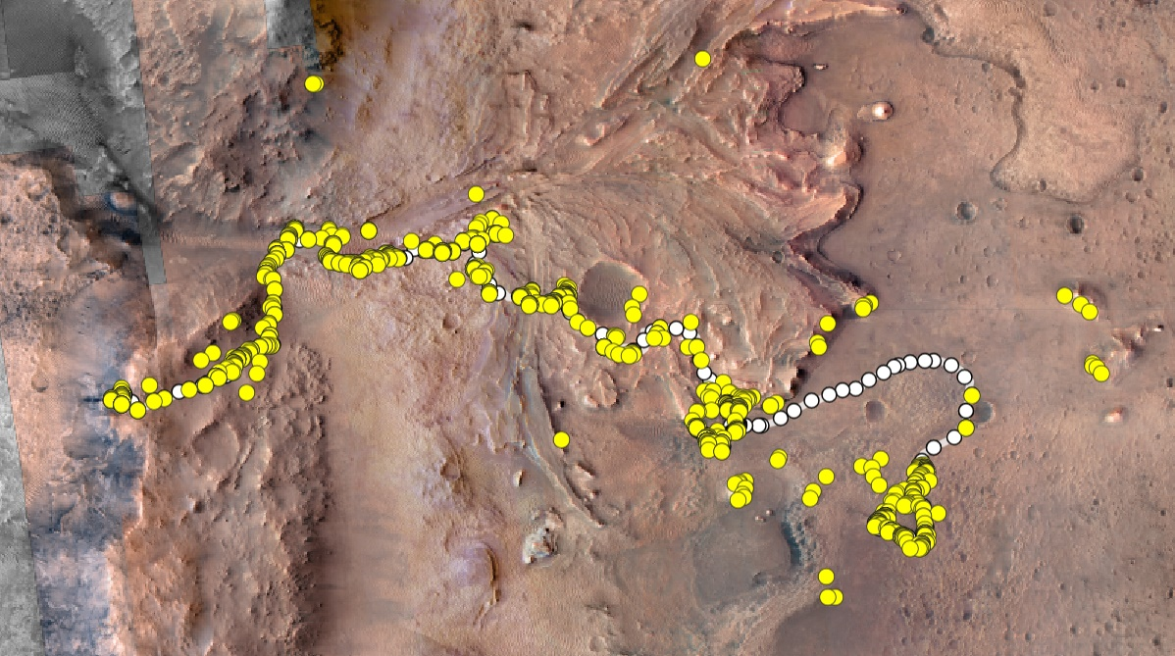
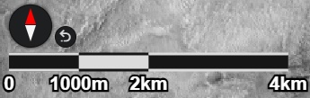
Status of SuperCam: Science—Rover Traverse
~35 km so far
Margin Unit
2023-2024
Delta Top
Campaign
2023
All techniques have contributed to SuperCam’s science
Top discoveries
Crater
Floor
Campaign
2021
Crater Rim
2024-
Delta Front
& Depot
2022
Landing Site
= Rover Stop
= SuperCam Observation

Slide 19
1. Publications 2. Collaboration
SuperCam publications are compiled in a separate document on the SuperCam workshop site. Some will be highlighted in the following presentations.
SuperCam leadership encourages team members to support people who are interested in digging into the data set. For those who would like more help than just answering a few questions, most team members would be happy to collaborate with people outside the team on the SuperCam data set

Slide 20
Points of Contact
See organization chart in backup slides
Name | Position | Affiliation | E-mail
Roger Wiens | Principal Investigator | Purdue U., Indiana, USA | rwiens@pudue.edu
Agnes Cousin | Principal Investigator, LIBS WG lead | IRAP, Toulouse, France | agnes.cousin@irap.omp.eu
Sam Clegg | Deputy PI | LANL, Los Alamos, NM, USA | sclegg@lanl.gov
Olivier Gasnault | Deputy PI | IRAP, Toulouse, France | olivier.gasnault@irap.omp.eu
Allison Zastrow | VISIR WG Lead | LANL, Los Alamos, NM, USA | a.m.zastrow@lanl.gov
Pierre Beck | VISIR WG Lead | U. Grenoble, France | pierre.beck@univ-grenoble-alpes.fr
Ann Ollila | LIBS WG Lead | LANL, Los Alamos, NM, USA | amo@lanl.gov
Jose-Antonio Manrique | Raman WG Lead | U. Valladolid, Spain | joseantonio.manrique@uva.es
Elise Clave | Raman WG Lead | DLR, Berlin, Germany | elise.clave@dlr.de
Baptiste Chide | Acoustic/Atm Lead | IRAP, Toulouse, France | baptiste.chide@irap.omp.eu
Tim McConnochie | Atm/Acoustic Lead | SSI, New York, USA | tmcconnochie@spacescience.org
Franck Montmessin | Atm/Acoustic Lead | LATMOS, Paris, France | franck.montmessin@latmos.ipsl.fr
Olivier Gasnault | Imaging Lead | IRAP, Toulouse, France | olivier.gasnault@irap.omp.eu
Stéphane Le Mouélic | Imaging Lead | U. Nantes, France | stephane.lemouelic@univ-nantes.fr
Co-Principal Investigators
  Roger Wiens, Purdue, Indiana, USA, rwiens@purdue.edu
  Agnes Cousin, IRAP, Toulouse, France, agnes.cousin@irap.omp.eu
Deputy Principal Investigators
  Sam Clegg, LANL, Los Alamos, USA, sclegg@lanl.gov
  Olivier Gasnault, IRAP, Toulouse, France, olivier.gasnault@irap.omp.eu
Working Group Leaders
  VISIR
    Allison Zastrow, LANL, Los Alamos, USA, a.m.zastrow@lanl.gov
    Pierre Beck, U. Grenoble, France, pierre.beck@univ-grenoble-alpes.fr
  LIBS / elemental chemistry
    Ann Ollila, LANL, Los Alamos, USA, amo@lanl.gov
    Agnes Cousin (see above)
  Time-resolved Raman & luminescence

Slide 21
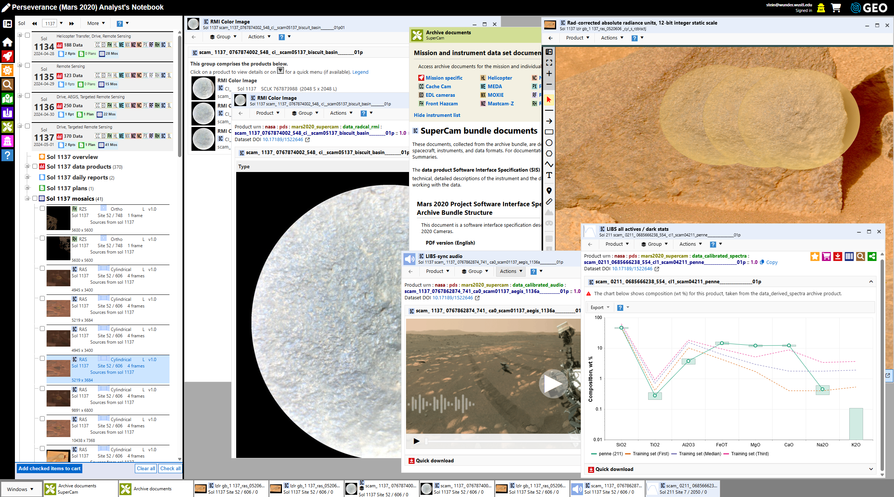
Shout out for Analyst Notebook
(Tom Stein, PDS)

Slide 22
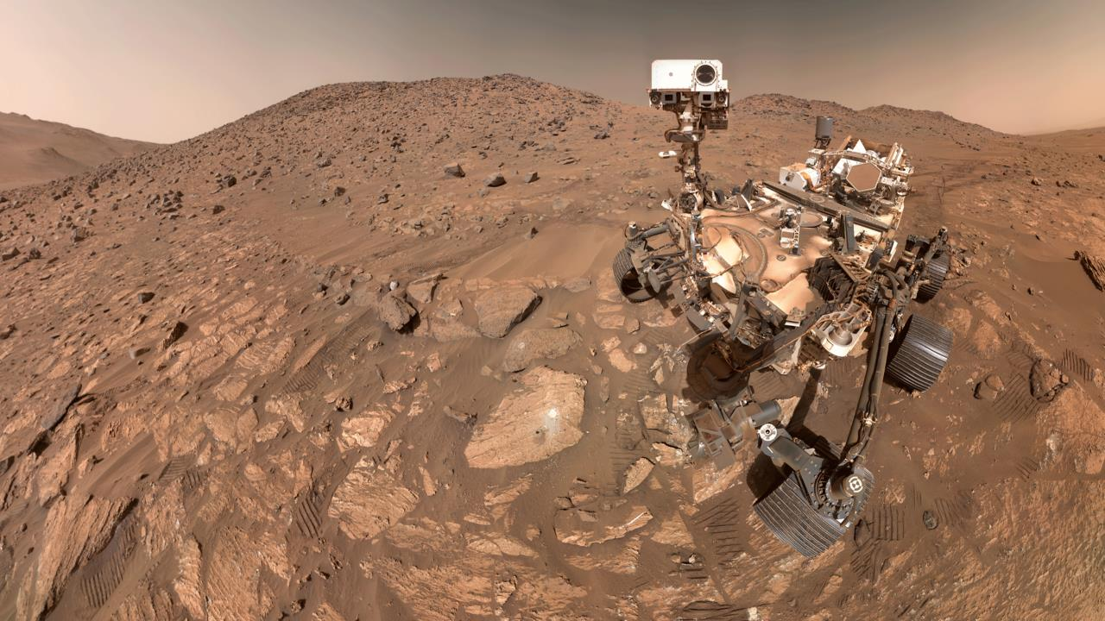
Thank You

Slide 23
Backup Slides

Slide 24
Python code for extracting LIBS, Raman, VIS and IRS
from astropy.io import fits
import numpy as np
import matplotlib.pyplot as plt
fits_file = 'Path_to_supercam_CDR_file.fits'
# Open the FITS file
with fits.open(fits_file) as hdul:
# Read Wave, Spectrum from LIBS, RAMAN or VIS CDR
wave = hdul['Wavelength'].data['Wavelength']
mean = hdul['Statistics'].data['Mean']
# Read Wave, Spectrum (including atm correction) from IRS CDR (replace the previous 2 lines)
# wave = hdul['Wavelength'].data['Wavelength (um)’]
# mean = hdul['Spectra'].data['I_F_atm’]
# retrieve metadata
header_entries = hdul[‘Primary'].header
# Plot the data
plt.plot(wave, mean)
plt.show()

Slide 25
Python code for extracting RMI images
from astropy.io import fits
import numpy as np
import matplotlib.pyplot as plt
fits_file = 'Path_to_supercam_CDR_file.fits'
# Open the FITS file
with fits.open(fits_file) as hdul:
# Read image data from the first RGB HDUs
image_data = [hdul['red'].data, hdul['green'].data, hdul['blue'].data]
# retrieve metadata
header_entries = hdul['Primary'].header
# Normalize the image data (use your own normalization method)
normalized_images = [img / np.max(img) for img in image_data]
# Stack the images to create an RGB image
rgb_image = np.stack(normalized_images, axis=-1)
# Display the imageplt.imshow(rgb_image)
plt.show()
# Save the image to a file
plt.imsave('output_image.png', rgb_image)

Slide 26
Python code for extracting microphone recordings
from astropy.io import fits
import numpy as np
import matplotlib.pyplot as plt
fits_file = 'Path_to_supercam_CDR_file.fits'
# Open the FITS file
with fits.open(fits_file) as hdul:
# Read time series for SuperCam Audio
sound_data = hdul['Sound'].data['Sound']
# retrieve metadata
header_entries = hdul['Primary'].header
# Plot the data
plt.plot(sound_data)
plt.show()

Slide 27
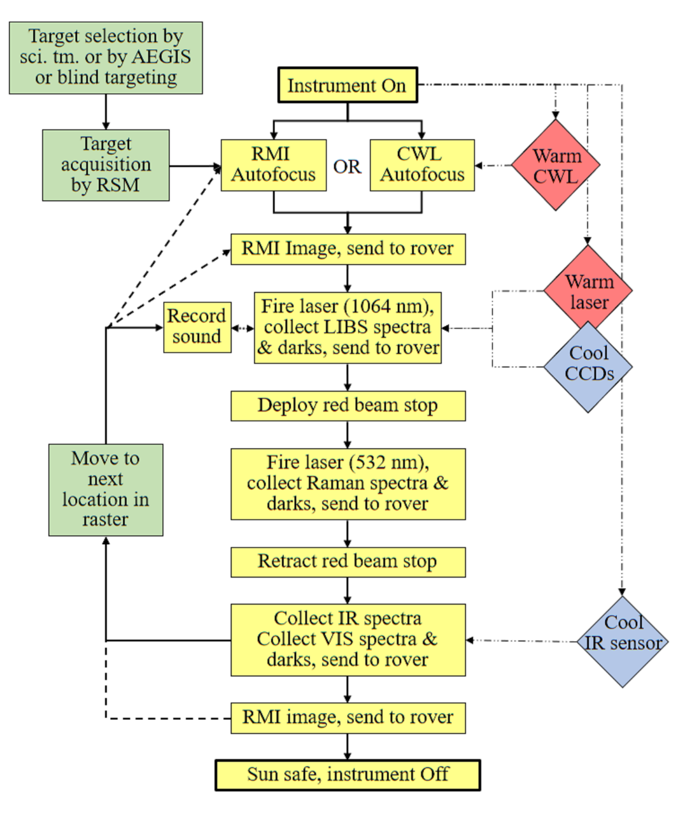
Operation Flow Chart

Slide 28
Building a 1x5 Raster
Focus
RMI image on 1st point
Spectral observations, 1st point: LIBS first to remove dust
Move mast and repeat spectral obs., points 2-4
Focus
Spectral observations, last point
RMI image on last point
(Additional focuses and RMIs are used on longer rasters)
Overlapping region contains image portions with and without the laser pits, depending on which image is used.

Slide 29
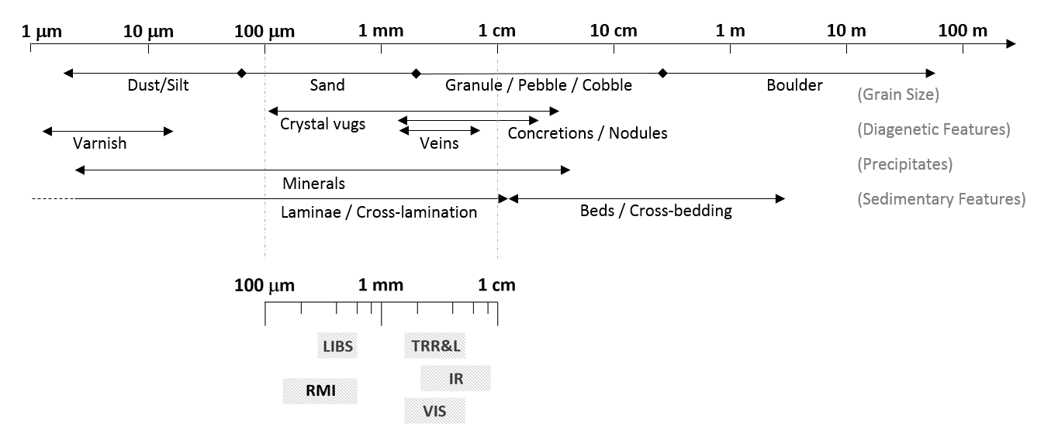
SuperCam’s Characteristic Scales
SuperCam’s characteristic scales are between 100 µm and 1 cm for targets between 2 m and 7 m
1.3-2.6 µm
0.4-0.85 µm

Slide 30
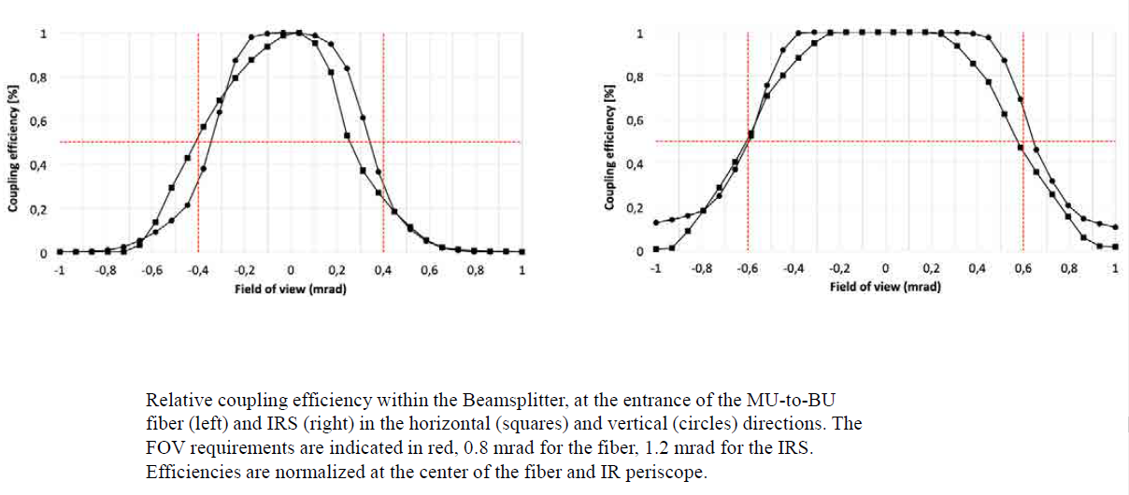
Fields of View of IR Spectrometer and Body Unit Spectrometers

Slide 31
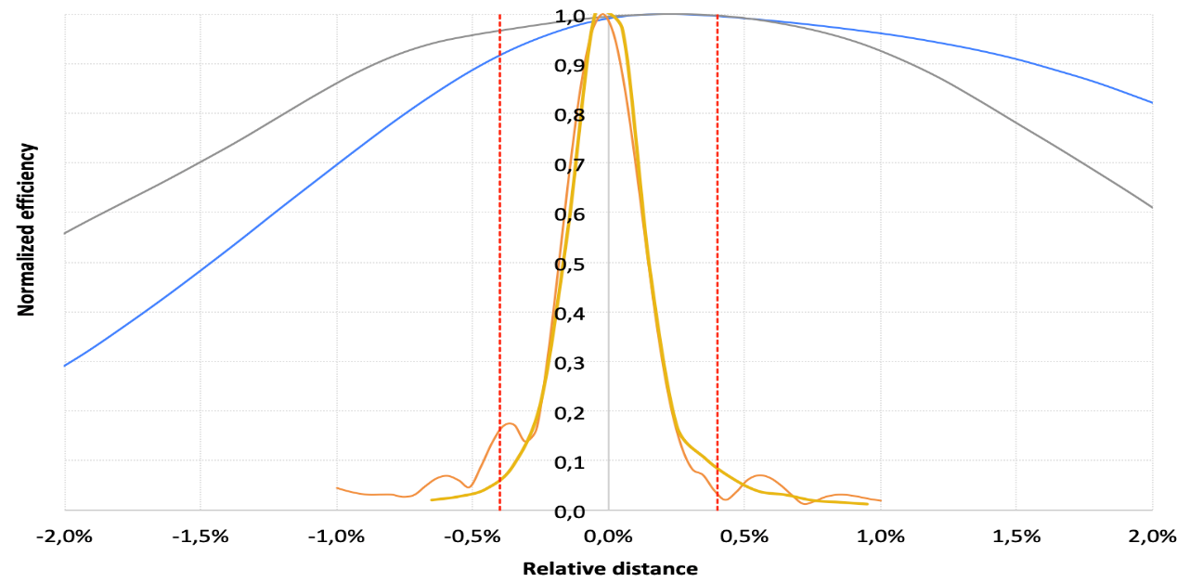
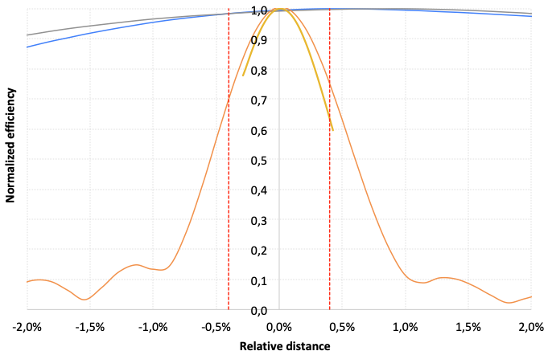
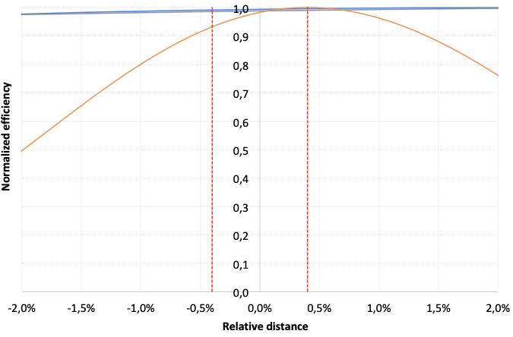
Depth of Focus for Each Technique
7 m
2 m
Depth of field at 2 m (top, left), at 7 m (top, right), at 30 m (bottom) for different performance criteria – see text for their definition: IR collect (blue), BU collect (grey), RMI (orange), plasma creation (yellow). The horizontal axis is variations of the focus distance with regards to the target distance.
30 m

Slide 32
SuperCam Organization Chart
SuperCam
Co-PI R. Wiens
Co-PI A. Cousin
DPI S. Clegg
DPI O. Gasnault
Science
GDS
Hardware
Operations
Science pipeline
P. Pilleri
M. Brand
Lab. units
LANL (S. Clegg)
IRAP (A. Fau)
Inst dev.
S. Robinson
Ph. Caïs
Ops centers
LANL (S. Robinson)
CNES (M. Bouyssou)
Bilbao (G. Arana)
Working groups
LIBS (A. Ollila, A. Cousin)
Raman (J.-A. Manrique, E. Clave)
VISIR (A. Zastrow, P. Beck)
Atmos. (T. McConnochie, F. Montmessin, B. Chide)
RMI (O. Gasnault)
Geochemistry (C. Bedford, C. Royer)
Staffing
Activity dev.
Characterizations
Anomaly res.
Uplink Tools
Database
P Pilleri
PDS delivery
A. Sheridan
sPUL, sPDL, CI rep., PEL, Project roles
Science team
Data experts
A. Sheridan
P. Pilleri
M. Brand
Inst. experts
T. Nelson
P. Bernardi
ePUL, ePDL
LANL
CNES
SCAM Ops Team (leads) S. Robinson, T. Nelson, M. Bouyssou/L. Peret, G. Lacombe
    This document has been reviewed and determined not to contain export controlled technical data.

