Slide 1
VISIR: Reflectance Spectroscopy
Allison Zastrow, on behalf of Pierre Beck, Adrian Brown, and the SuperCam VISIR Working Group
SuperCam Data Workshop
LPSC, The Woodlands, Texas, USA
Tuesday, March 11, 2025

Slide 2
OUTLINE
Brief explanation of reflectance spectroscopy
SuperCam VISIR Details
Basics and calibration info
Where to get the data on the PDS
SuperCam-specific “things to watch out for”
SuperCam VISIR papers

Slide 3
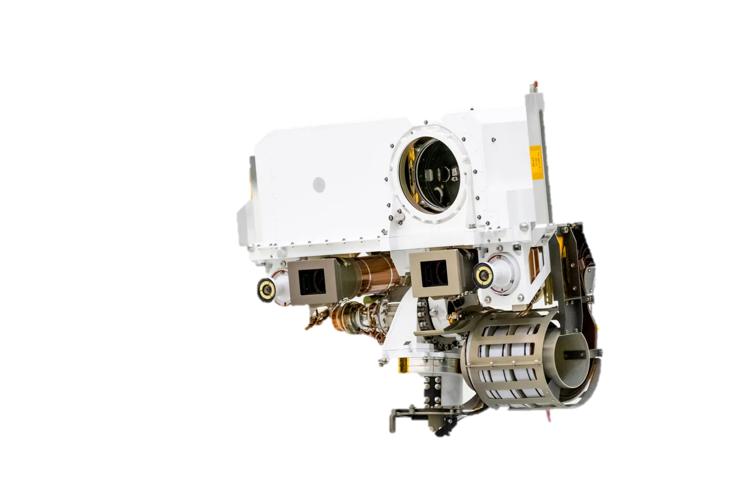
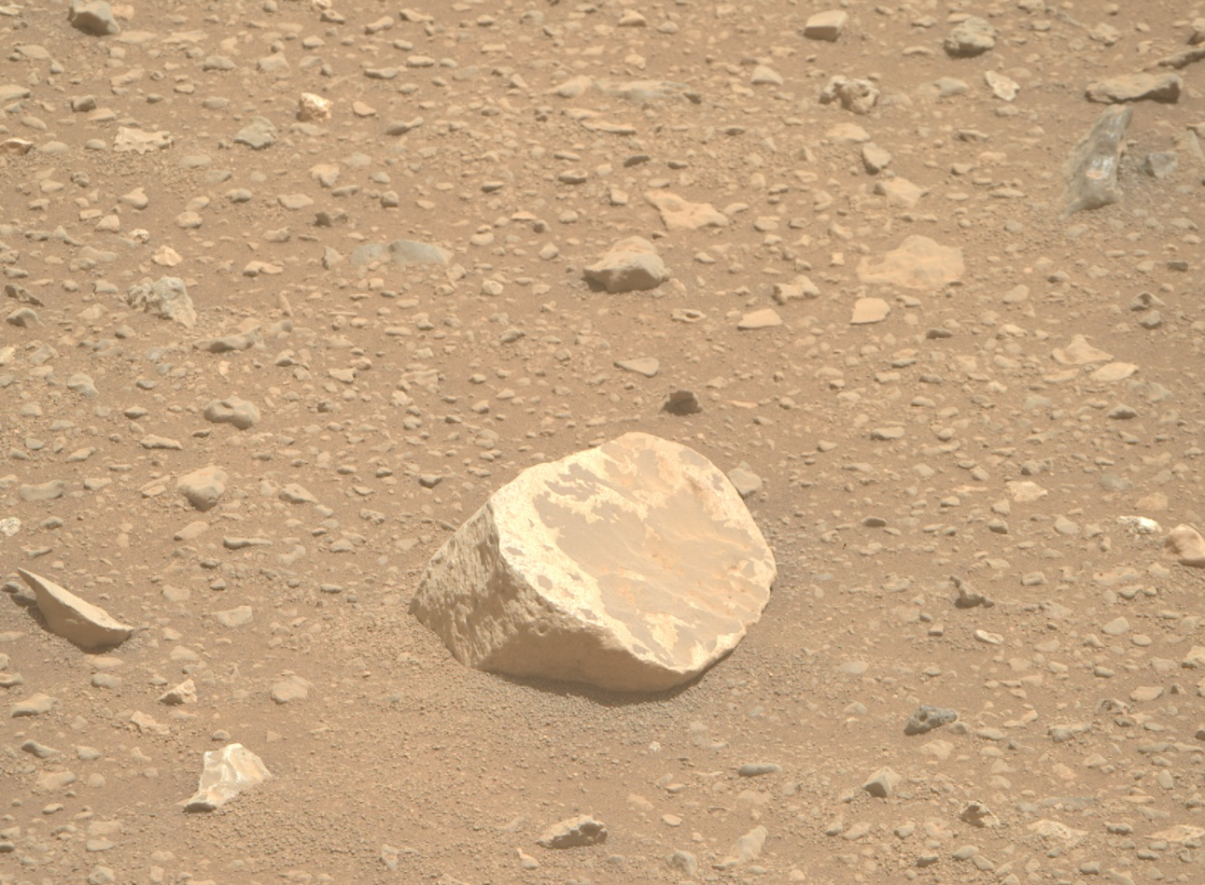
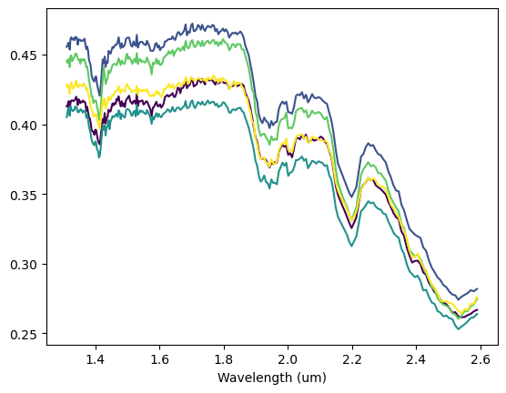
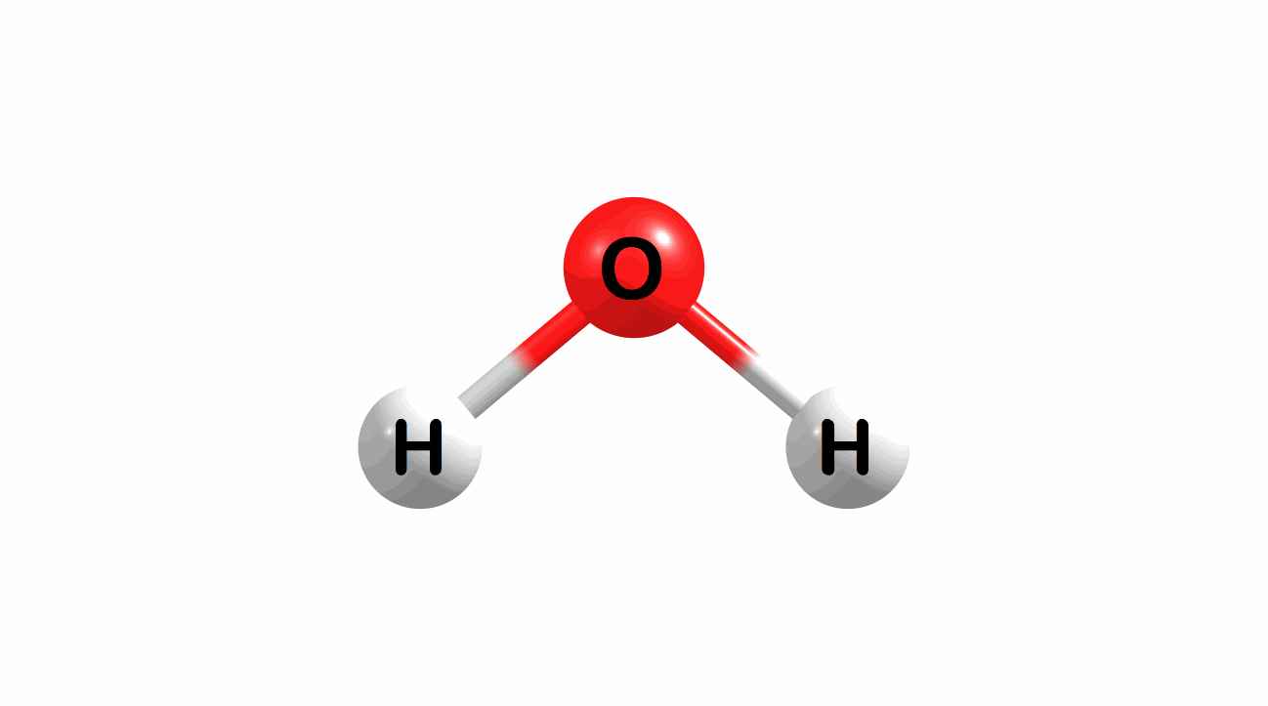
Reflectance Spectroscopy
Chignik, sol 681

Slide 4
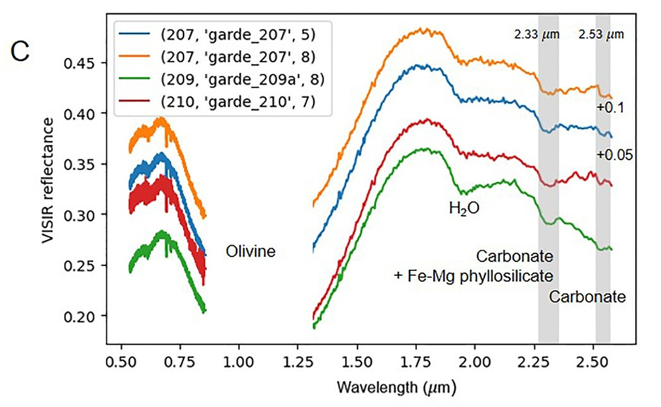
SuperCam VISIR Basics
Two spectral ranges measuring passive reflectance
VIS
Wavelength range: ~0.38 µm to ~0.85 µm over 5925 wavelength channels, with a gap between 0.465 µm and 0.537 µm
Spectral resolution: 0.2 nm (@ shorter wavelengths) to 0.65 nm (@ longer wavelengths)
Field of view: 0.74 mrad
IRS
Wavelength range: ~1.3 µm to ~2.6 µm over 256 wavelength channels
Spectral resolution: 5 nm (@ shorter wavelengths) to 20 nm (@ longer wavelengths)
Field of view: 1.15 mrad
Note: this figure doesn’t include the shortest VIS wavelengths (< 0.5 µm)
Clavé et al. (2023), JGR-Planets
https://doi.org/10.1029/2022JE007463

Slide 5
Calibration Info
IRS
Saturation check
Dark smoothing to keep only the low frequency trend
Dark subtraction
Conversion to radiance using Sol 20 white SCCT measurement as reference (in CDR file as “Radiance”)
Thermal calibration
Glitch removal
Spikes removal
Conversion to reflectance (in CDR file as “I_F”)
Atmospheric correction (in CDR file as “I_F_Atm”)
Important notes:
VIS and IRS are separate spectrometer systems with separate calibration methods
VIS region has NOT been corrected for atmospheric opacity
VIS
Saturation check
Dark subtraction
Conversion to radiance
Conversion to relative reflectance through division by Sol 184 observation of SuperCam calibration target (SCCT) white target, and scaling by illumination geometry
For more details: https://pds-geosciences.wustl.edu/m2020/urn-nasa-pds-mars2020_supercam/document/M2020_SuperCam_EDR_RDR_SIS.pdf
https://pds-geosciences.wustl.edu/m2020/urn-nasa-pds-mars2020_supercam/document/SuperCam_PDS_Userguide.pdf

Slide 6
How to find the data on the PDS
https://pds-geosciences.wustl.edu/m2020/urn-nasa-pds-mars2020_supercam/data_calibrated_spectra/
File identifiers
VIS → “cp3”
IRS → “cp2”
VIS
Data (“Statistics_Reflectance”): HDU 7
Mean, Median, and Standard Deviation
Wavelength: HDU 8
Wavelength and IRF info
Other useful data
Saturation (HDU 9)
Header (HDU 0)
Number of wavelength channels for each region of the spectrometer
ODL Label (HDU 1)
Observation viewing geometry, etc.
IRS
Data (“Spectra”): HDU 6
Radiance, I_F, I_F_Atm, and other observation-specific calibration data
Wavelength: HDU 8
Other useful data
Data Quality (HDU 9)
Saturation, glitches, etc.
Header (HDU 0)
“DP_IR_PF”: Power flag
Good → “False” (should be False in all CDR files)
Bad → “True” or blank
ODL Label (HDU 1)
Observation viewing geometry, etc.

Slide 7
Things to watch out for
VIS and IRS are separate spectrometer systems with separate calibration methods
VIS region has NOT been corrected for atmospheric opacity
1 µm region is not measured, so band depth can only be interpreted qualitatively, given that offsets between VIS and IRS relative reflectance values may exist
Possible artifacts in both spectrometers due to various reasons (examples in the slides to follow)

Slide 8
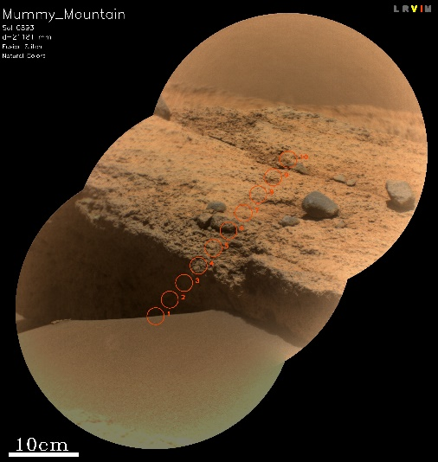
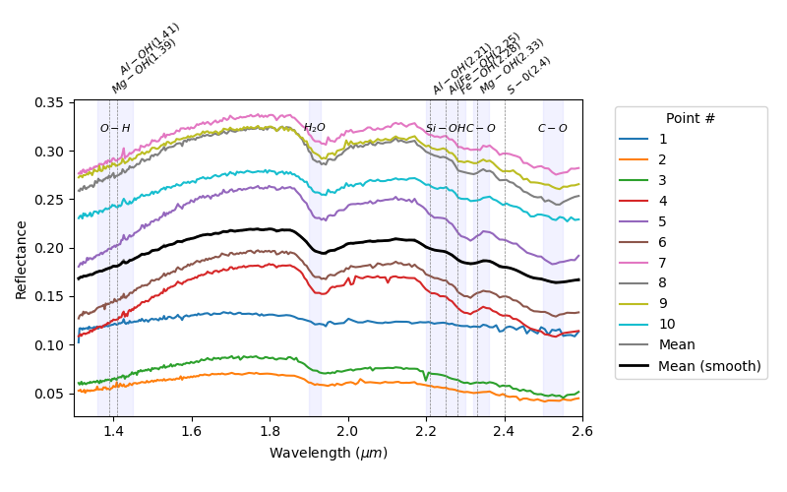
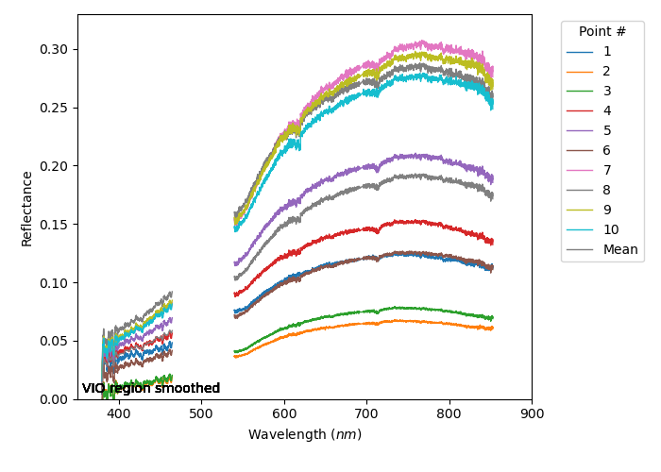
VIS and IRS: Things to watch out for
Shadowed spectra occur and measure only diffuse reflectance
Reflectances in shadowed locations are typically <0.06 in VIS
Reflectances in shadowed locations are typically <0.1 in IRS

Slide 9
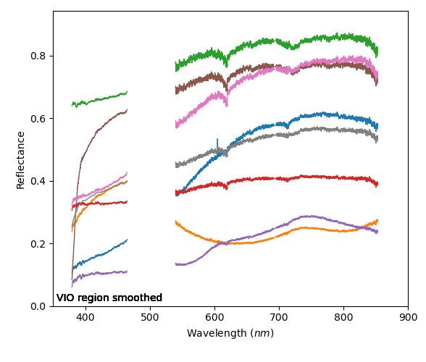
VIS: Things to watch out for
Artifacts at ~620nm and ~714nm
are due to where detector regions join/end
(can be more pronounced for high-reflectance targets)
Organic01
Cyan
IR white
Calcite
Chert
White paint
ZCAM white
Mean
Note: VIO (violet-blue spectrometer region) is not smoothed in CDR data on the PDS

Slide 10
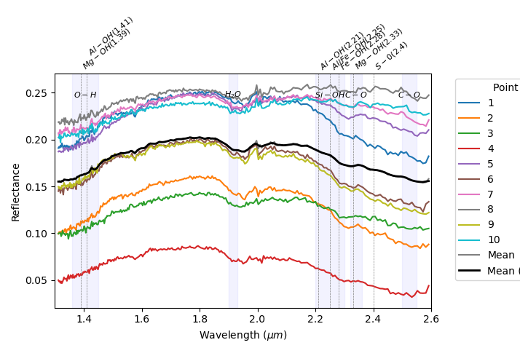
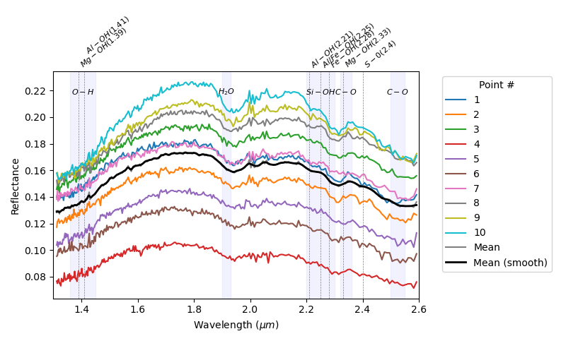
IRS: Things to watch out for
Atmospheric correction residuals:
be careful to not make interpretations solely
on these features
RF power failure
Burnt_Island_996
Spectra with power failures are only released to the PDS as EDRs, not as CDRs
Frying_Pan_Spring_1058
These wiggles are due to imperfect correction of CO₂

Slide 11
SuperCam VISIR Papers
Instrument/calibration papers:
Wiens et al., 2021 (Body Unit); https://doi.org/10.1007/s11214-020-00777-5
Maurice et al., 2021 (Mast Unit); https://doi.org/10.1007/s11214-021-00807-w
Manrique et al., 2020 (Calibration targets, design); https://doi.org/10.1007/s11214-020-00764-w
Madariaga et al., 2021 (Calibration targets, homogeneity); https://doi.org/10.1016/j.aca.2022.339837
Cousin et al., 2021 (Calibration targets, characterization); https://doi.org/10.1016/j.sab.2021.106341
Legett et al., 2022 (Optical calibration of spectrometers); https://doi.org/10.1364/AO.447680
Fouchet et al., 2022 (IRS spectrometer); https://doi.org/10.1016/j.icarus.2021.114773
Royer et al., 2020 (Pre-launch calibration of IRS spectrometer); https://doi.org/10.1063/1.5145390
Royer et al., 2022 (Post-landing calibration of IRS spectrometer); https://doi.org/10.1029/2022JE007481
VISIR data papers:
Wiens et al., 2022 (Crater floor synthesis paper); https://doi.org/10.1125/sci-adv.abo3399
Mandon et al., 2023 (Crater floor mineralogy); https://doi.org/10.1029/2022JE07450
Clavé et al., 2023 (Carbonate detection); https://doi.org/10.1029/2022JE007463
Mandon et al., 2024 (Fe-mineralogy); https://doi.org/10.1029/2023JE008254
Royer et al., 2024 (High-Al rocks); https://doi.org/10.1038/s43247-024-0183702
Beck et al., 2025 (High-Si rocks); https://doi.org/10.1016/j.epsl.2025.119256
Royer et al., 2025 (Multi-gaussian modeling of IRS data); in press, Icarus
VISIR papers in progress:
Connell et al. (Dehydration experiment), in prep
Quantin-Nataf et al., (Comparisons between CRISM and SCAM observations), in prep
Zastrow et al., (IRS machine learning), in prep
Please feel free to reach out to the team with data questions or research inquiries!

Slide 12
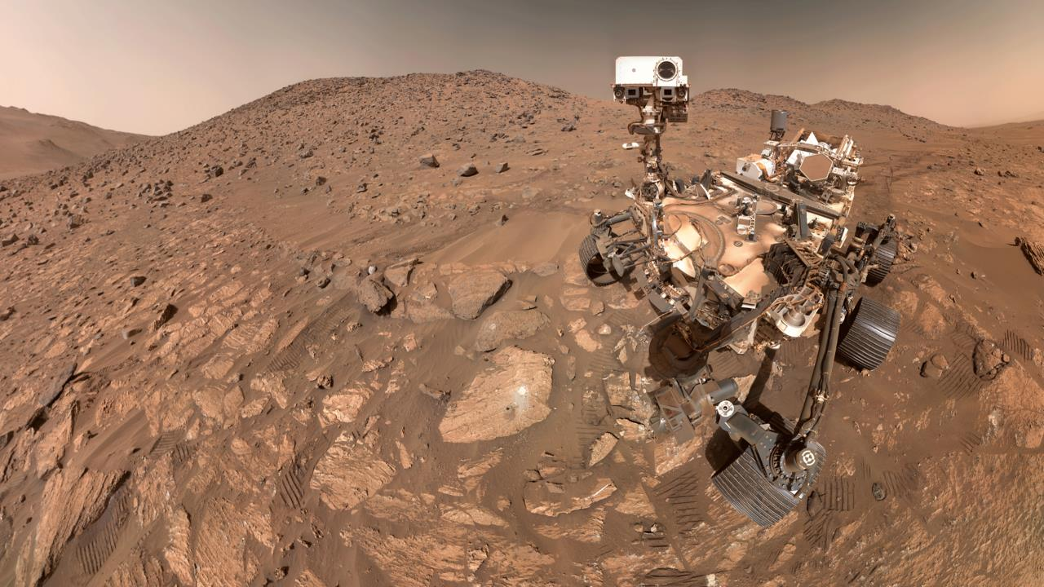
Thank You

