Slide 1
Time-resolved Raman and luminescence spectroscopy
Presented by A. Ollila on behalf of the Raman WG
Points of contact: E. Clavé & J.A. Manrique
SuperCam Data Workshop
LPSC, The Woodlands, Texas, USA
Tuesday, March 11, 2025

Slide 2
OUTLINE
General info on time-resolved Raman and luminescence spectroscopy
Specificities of the SuperCam Raman instrument
Some statistics and example of spectra
Things to know about the data: access, processing, artifacts, …

Slide 3
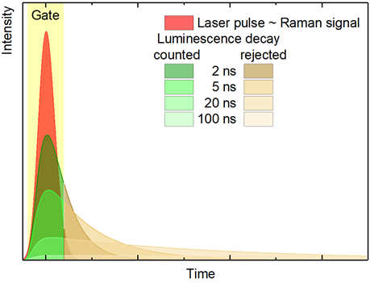
Raman and/or luminescence & time resolution
To limit or investigate luminescence: use the different lifetimes => time-resolved spectroscopy
Electronic excited level
Relaxation
Lifetime:
Raman ≈ 10⁻¹⁴ sec.
Luminescence / Fluorescence > 10⁻⁹ sec
Virtual energy level
532
Electronic transition
Luminescence
Luminescence
Raman
Rayleigh
Ground energy levels
Raman shift
Laser might excite the subtle Raman signal and the subtle yet generally stronger luminescence
Of course Raman is interesting but luminescence as well ! (see works by M. Gaft, L. Nasdala, G. Panczer, G. Waychunas, J Gotze …)
Pasteris & Beyssac, Elements 2020; Beyssac, Elements 2020

Slide 4
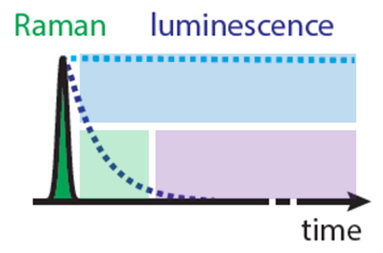
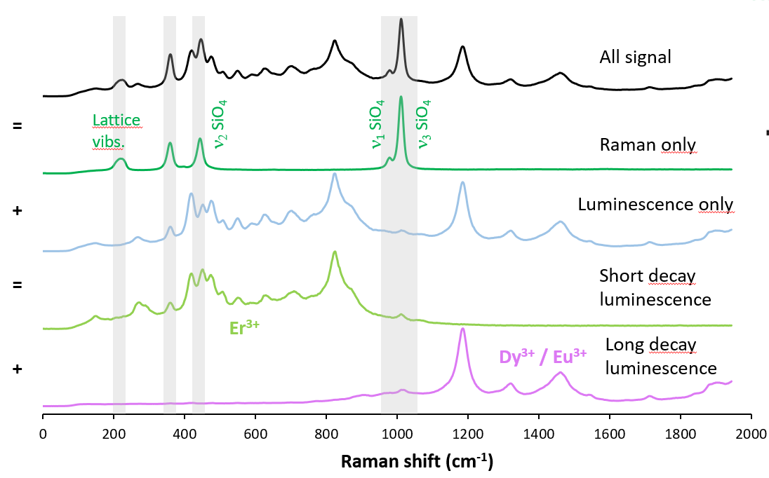
Raman and luminescence in a zircon: de-mixing with time-resolution
Using the appropriate set of gate delay and gate opening it is possible to:
fully reject luminescence,
fully reject Raman and explore luminescence of rare-Earth elements (REE) and other trace elements
Fau et al. American Mineralogist 2022; Malarewicz et al. J. of Raman Spec. 2023

Slide 5
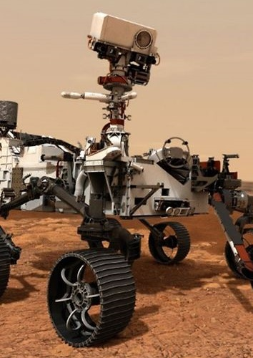
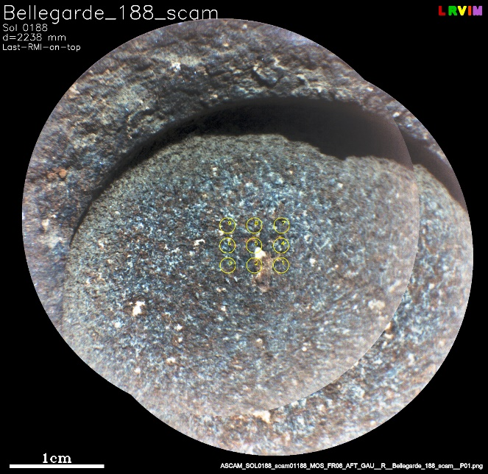
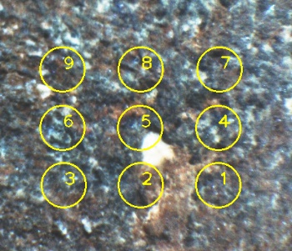
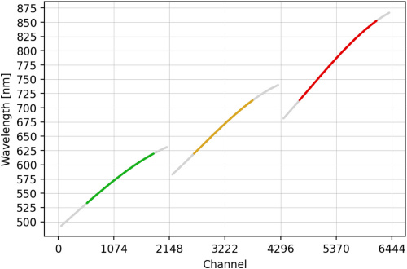
SuperCam Raman in a nutshell
SPECTRUM ACQUISITION STARTS
LASER FIRES (X10)
R.C. Wiens et al. 2021
S. Maurice et al. 2021
CCD STARTS ACCUMULATING
DELAY GENERATOR
EXCITATION | WAVELENGTH | 532 nm
 | PULSE ENERGY | 12 mJ
 | PULSE WIDTH | 3-4 ns
 | REP. RATE | 10 Hz
 | BEAM SHAPE | Collimated (8.4 x 9.3 mm on target)
 | POWER DENSITY | 30 kW/mm2
COLLECTION | OPTICAL DESIGN | Schmidt-Cassegrain
 | APPERTURE | 110 mm
 | FOCAL LENGTH | 700 mm
 | N.A. | 0.078
 | FOOTPRINT | 0.74 mrad (1.48 mm @ 2 meters)
SPECTROMETER | MONOCHROMATOR | Transmission, three tracks, F4
 | DETECTOR | Intensified CCD
 | CHANNELS | 2048 pixels (1680 under intensifier)
 | SPECTRAL COVERAGE | 532 - 850 nm / 0 - 7032 cm-1
 | GATE WIDTH | from 100 ns
 | GATE DELAY | Adjustable
 | INTEGRATE ON CHIP | Available
EXCITATION & COLLECTION
Mast Unit
INTENSIFIER TUBE GATING #1
TRIGGER #1
NOTCH FILTER
10 COADDS
OPTICAL FIBER
(6 METERS)
INTENSIFIER TUBE GATING #10
TRIGGER #10
Temporal schematics of typical SuperCam acquisition of 1 spectrum with 10 coadds (i.e. accumulating the signal from 10 laser shots on the CCD)
EDGE FILTER
CCD READOUT
SPECTROMETER
Body Unit
SPECTRUM ACQUIRED
Intensifier tube
3 distinct spectral ranges:
-Green (532 – 620 nm)
-Orange (620 – 712 nm)
-Red (712 – 853 nm)
--> stitched together in pipeline
The footprint covers several mineral grains, spectra may present mixed features.
Notes:
Power density prevents alteration from laser (to the best of our knowledge).
Collimated excitation → constant power density
Standoff detection from 2 meters → variable coverage of the spectrometer hence, analytical footprint.
Gated detector manages 2 values:
CCD exposure, this is for how long the CCD is collecting light before readout.
Gate: Only during gating the intensifyer lets light go through. Gate width can be as low as 100 ns. Delay between laser fire and gate can be controlled → Time Resolving Power.
SuperCam can integrate several Gatings in one CCD exposure. We call this coadds.
Raman event lasts for 4 ns, gate 100 ns → “Temporal Depth of Field” during the gate Raman from different distances can get to the CCD, delay is rarely altered.

Slide 6
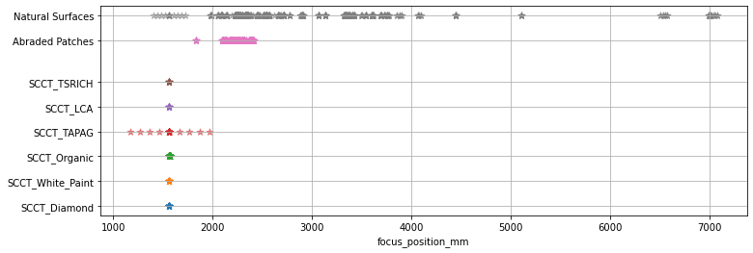
Some statistics on Raman instrument use Two main kinds of targets: SuperCam Calibration Targets (SCCTs, 6 of them for Raman) and Mars targets (Natural surfaces or Abraded Patches)
Frequency of observations and number of spectra per category of targets (up to sol 1365)
SCCTs are observed regularly for instrument calibration and/or target monitoring (see next slide).
Distance of targets (focus position in mm)
SCCTs are at 1.6 m (one focus sweep on the TAPAG_SCCT).
Abraded patches are typically closer to the rover (need access with robotic arm).

Slide 7
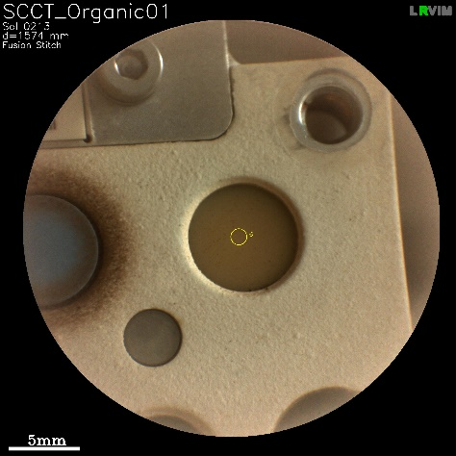
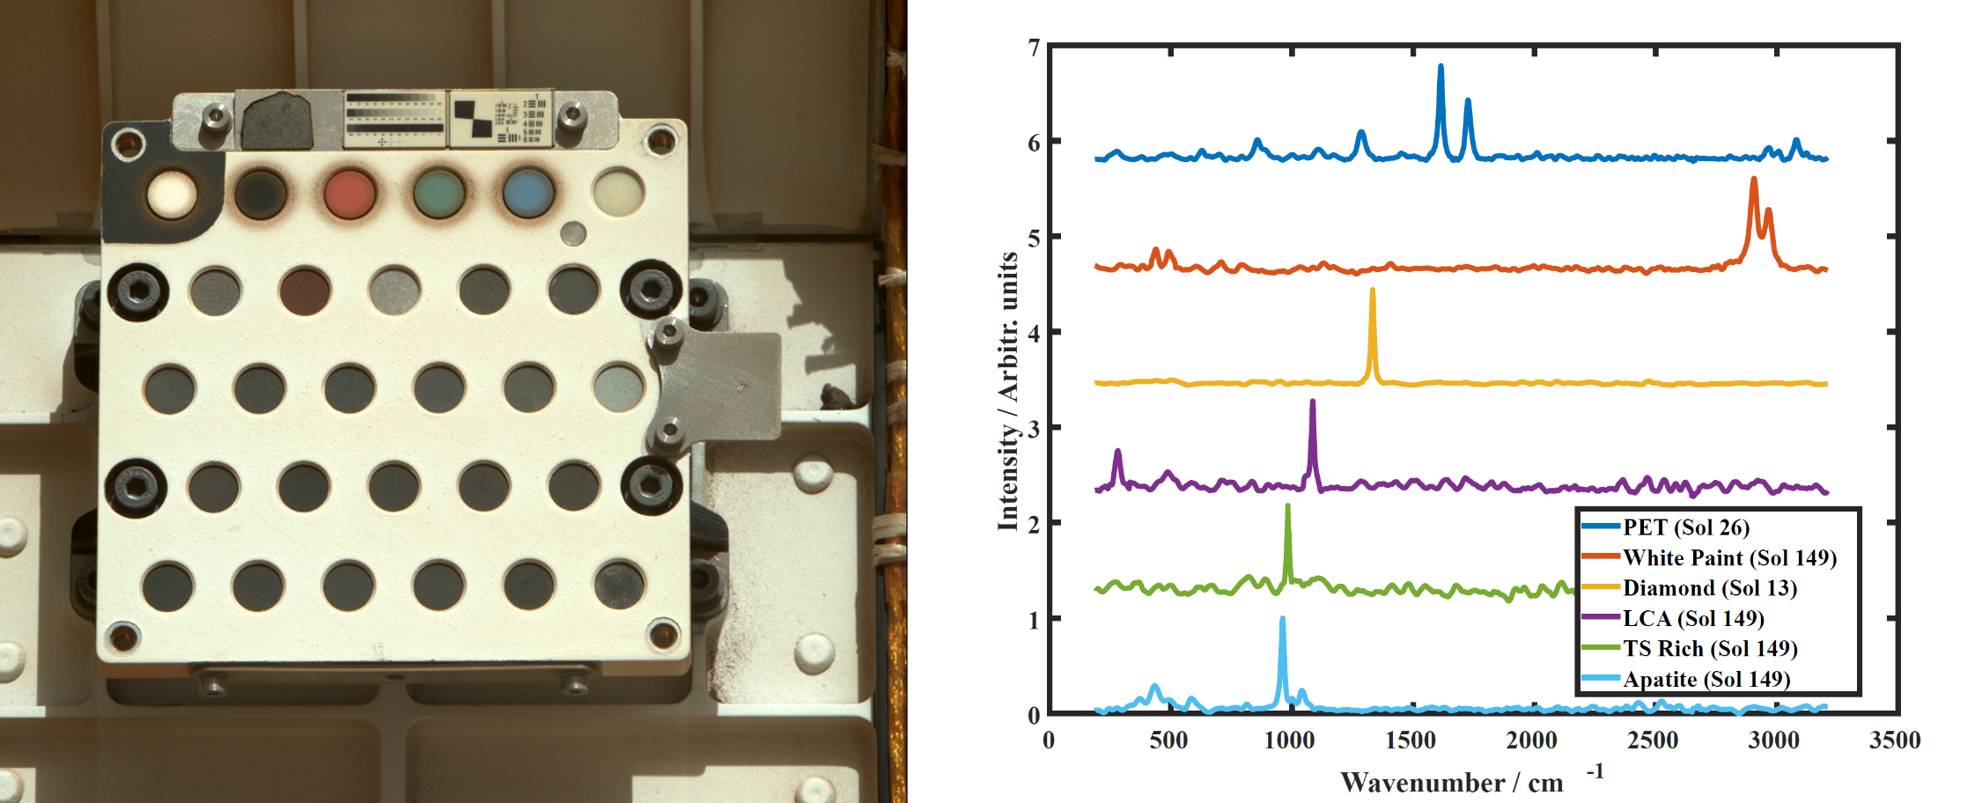
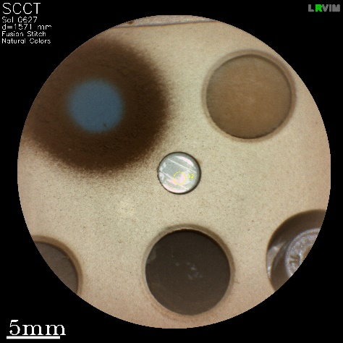
SuperCam Calibration Targets (SCCTs) & corresponding Raman spectra
SuperCam calibration target (SCCT, Manrique et al. 2020, Cousin et al. 2022, Madariaga et al. 2022) soon after its arrival on mars (left). Examples of Raman spectra acquired on the SCCT (right), from Lopez-Reyes et al., sub. (1000 sols). All spectra are normalized and baseline subtracted.
Diamond target: First Raman spectrum acquired out from Earth. Provides high intensity spectrum with narrow feature for health checks of the instrument.
PET target: Organic detection test and evaluation of the degradation of organics on Mars (Sylvain et al. in rev.).
White paint (Perseverance’s paint): Provides several Raman features in its spectrum. Considered stable under Mars environment, its potential ageing is checked by SuperCam Raman.
Calcite (LCA): Carbonate standard for Raman.
Apatite (TAPAG): phosphate reference for Raman. Ageing by UV is monitored through SuperCam Raman data (Clave et al. 2024)
TS Rich: Mixture of basalt standard and K-sulfate. Sulfate reference for Raman
Manrique et al., 2020
Madariaga et al., 2020
Lopez-Reyes et al., sub.

Slide 8
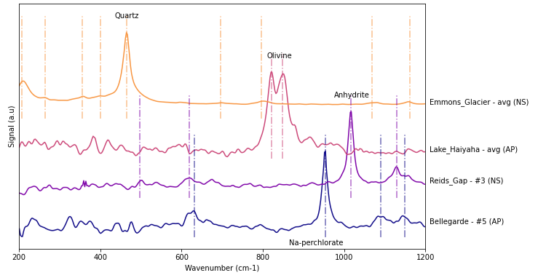
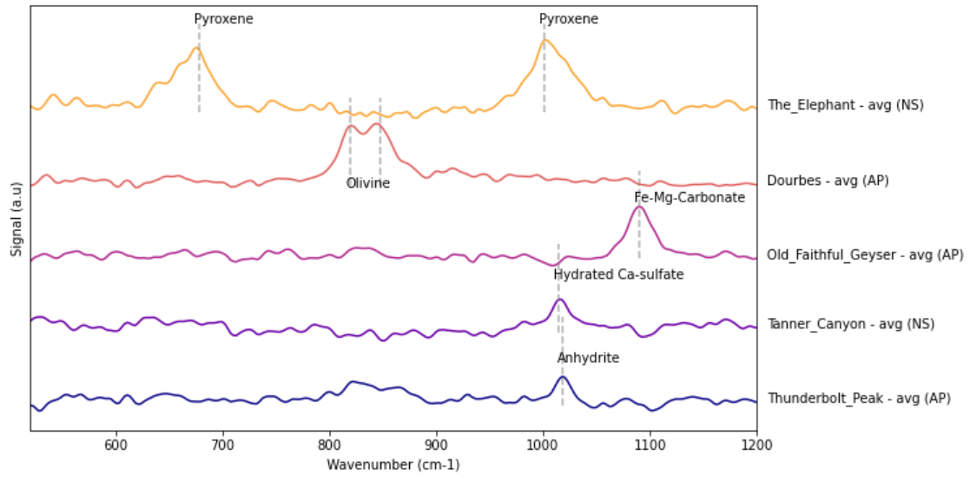
Example of Raman spectra acquired on Mars targets
Best spectra:
Na-perchlorate (sol 188), Anhydrite (sol 466), olivine (sol 853) and quartz (sol 1315)
SNR up to 650 !
--> on light-toned veins or fracture fills, abraded patches and dust-free, coarsely crystallized natural surfaces
Other detections:
Anhydrite (sol 896 and many others) and possibly hydrated Ca-sulfate (sol 1189), Fe-Mg-carbonate (sol 1154 and many others), olivine (sols 259-278 and many others) and pyroxene (sol 1366)
SNRs typically around 3 - 50
NS: Natural Surface – AP: Abraded Patch
Avg: Mean spectrum of all point on the target - #x spectrum acquired on one specific point.
Spectra are offset for better visibility.

Slide 9
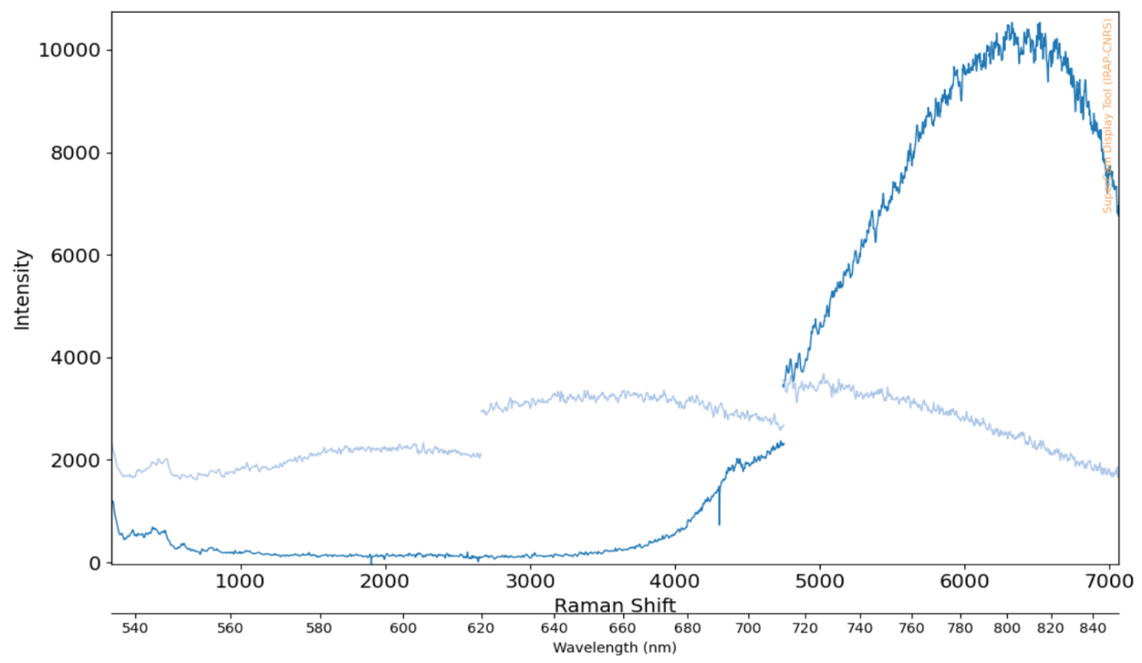
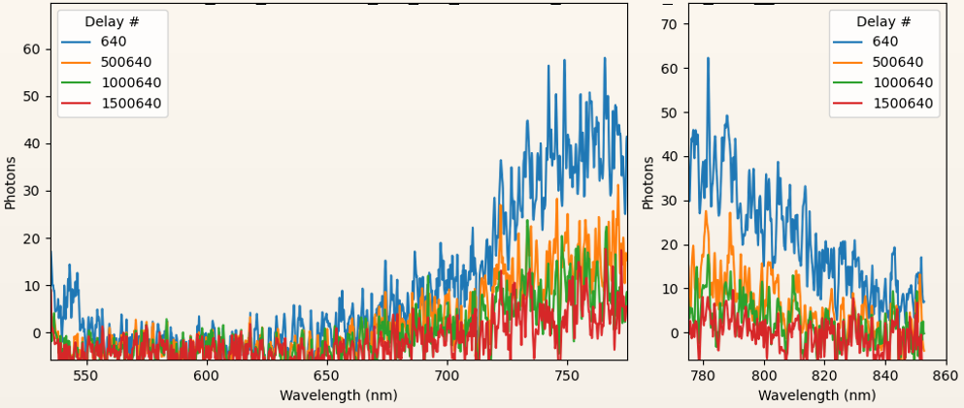
Example of luminescence signatures observed on Mars targets
Dedicated Luminescence Activities
Opportunistic Luminescence Activities
Search for weak and/or long-lived luminescence
Conducted after sunset to avoid reflected sunlight during long (0.5 ms) collections
Either single spectrum collections or time series to calculate lifetime
Only features observed so far are broad and weak with a peak center around 760 nm, potentially from Fe³⁺ in feldspar
Identified during Raman observations
Short collection times (100 ns) indicate intense signal
Broad features covering the whole range (e.g. Steamboat Mountain) may be due to prompt fluorescence / scattering
Broad features centered around 810 nm may be Cr³⁺
Steamboat Mountain #9 (Sol 1192)
Coral Bay #7 (Sol 924)
Guillaumes (Sol 163)
Time series

Slide 10
Raman data pipeline & Products available on PDS
Dark coadds
Active coadds
EDRs (raw data, not calibrated, channel vs digital counts)
Shot 2 Shot Despiking
Shot 2 Shot Despiking
SuperCam PDS page: https://pds-geosciences.wustl.edu/missions/mars2020/supercam.htm
Details on each processing step on the PDS here
Also presented in Lopez-Reyes et al., sub (1000 sols overview)
users are strongly encouraged to use calibrated data (CDRs, here) and refer to the list of signatures ("derived spectra data collection", here), updated every 6 months
Averaging Darks
Dark subtraction
Statistics computation
Spectral ranges stitching
Denoising
Instrument Response Function (IRF) correction
Wavelength calibration
Sigma clipping on median
Calibrated spectra
CDRs (calibrated data:
calibrated darks and active coadds + statistics)
Anderson et al., 2021, pipeline
Legett et al., 2022, IRF
Lopez-Reyes et al., sub.
Assessment of Raman and luminescence signatures
List of signatures

Slide 11
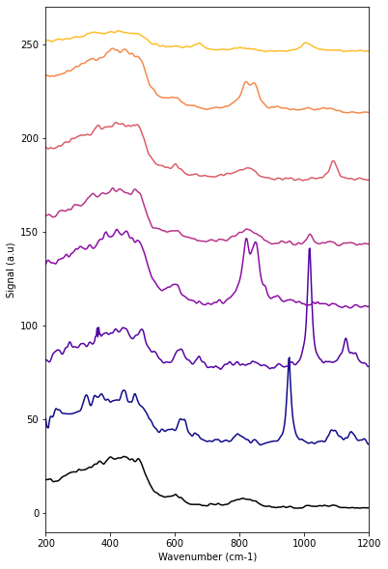
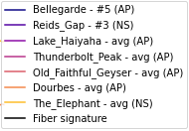
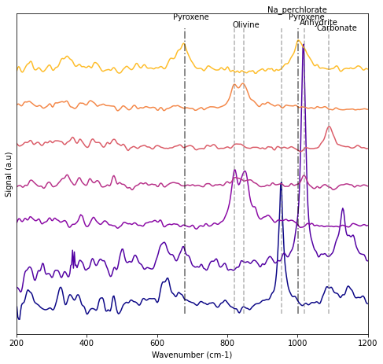
Dealing with the contribution of the optical fiber, aka the “fiber bump”
→ Using the reference fiber spectrum, the fiber contribution can be fitted and subtracted from spectra. This is especially useful for olivine assessment.
CDR data as can be downloaded from PDS
→ Often show these features below 500 cm⁻¹, around 600 cm⁻¹, 800 cm⁻¹ and above 1000 cm⁻¹
Reference signature of the fiber (amorphous silica)
Available on PDS

Slide 12
Useful parameters to understand to read Raman fits files & masterlist
General target parameters: Sol, Focus_distance_mm (distance of the target in mm), LTST: time of day of the observation
Acquisition related parameters:
Number of shots and combination:
Nactive: number of active spectra recorded (i.e. number of coadds)
Ndarks: number of dark spectra recorded (all darks acquired at the beginning/ end of the activity; averaged together before dark subtraction)
Nshots: total number of shots for the spectrum (i.e. all coadds together)
Temporal parameters:
Gate
Delay
Gain
Note: we now mostly get 2 spectra per point --> should be averaged together (after checking that a potential signature is visible in both, to rule out noise)
Another parameter affecting Raman signal: Temperature (can affect signal intensity, see Bernard et al., accepted)
In the masterlist (here): primary mirror temperature
In the fits files: CCD temperature and intensifier temperature

Slide 13
Main team publications
Instrument:
Wiens et al., 2021 (Body Unit); https://doi.org/10.1007/s11214-020-00777-5
Maurice et al., 2021 (Mast Unit); https://doi.org/10.1007/s11214-021-00807-w
Manrique et al., 2020 (Calibration targets, design); https://doi.org/10.1007/s11214-020-00764-w
Madariaga et al., 2021 (Calibration targets, homogeneity); https://doi.org/10.1016/j.aca.2022.339837
Cousin et al., 2021 (Calibration targets, characterization); https://doi.org/10.1016/j.sab.2021.106341
Legett et al., 2022 (Optical calibration of spectrometers); https://doi.org/10.1364/AO.447680
SuperCam Raman/ TRLS papers:
Clavé et al., 2024 (deterioration of apatite under UV); https://doi.org/10.1038/s41598-024-61494-5
Bernard et al., accepted (deterioration of ertalyte under UV)
Lopez-Reyes et al., sub. (1000 sols overview paper, ref. for all processing and results so far!);
(Pre-print https://doi.org/10.22541/essoar.174051870.09576363/v1)
Lopez-Reyes, sub. (olivine Fo/Fa characterization)
Team papers using Raman/ TRLS data:
Wiens et al., 2022 (crater floor, perchlorate detection); https://doi.org/10.1126/sciadv.abo3399
Clavé et al., 2023 (crater floor, carbonate detection); https://doi.org/10.1029/2022JE007463
Beyssac et al., 2023 (Seitah, olivine detection); https://doi.org/10.1029/2022JE007638
Simon et al., 2023 (Crater floor samples); https://doi.org/10.1029/2022JE007474
Bosak et al., 2024 (Fan Front samples); https://doi.org/10.1029/2024AV001241
Beck et al., accepted (silica and quartz, hydrothermalism); https://doi.org/10.1016/j.epsl.2025.119256
Hurrowitz et al., in rev. (Bright Angel, potential biosignatures)
Papers in preparation:
SuperCam Raman/ TRLS papers
Ollila et al. (TRLS)
Sharma et al. (Raman performance)
Kelly et al. (fiber, reflectance)
Team papers using Raman/ TRLS data:
Beyssac et al. (olivine boulders)
Clavé et al. (carbonate overview)
Connell et al. (dehydration experiment)
Mandon et al. (Bright Angel results, overview)
Siljeström et al. (Margin Campaign samples)
Weiss et al. (Upper Fan Campaign samples)
Some key abstracts (not yet in papers):
Meslin et al., LPSC 2022 (perchlorate)
Lopez-Reyes et al., LPSC 2023 (anhydrite veins)
Beyssac et al., LPSC 2023 (olivine boulders)
Clavé et al., LPSC 2023 (continuum signal)
Ollila et al, LPSC 2024 (TRLS)
Manrique et al., LPSC 2025 #2333 (new results, quartz & continuum) --> today's poster session !
We're looking forward to seeing what YOU will do with this data !
Please, reach out to SuperCam team members if you have questions !

Slide 14
Backup Slides

Slide 15
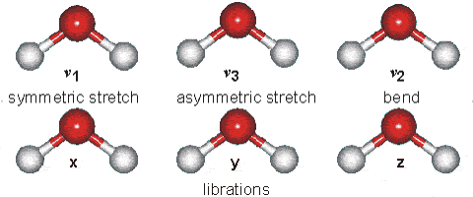
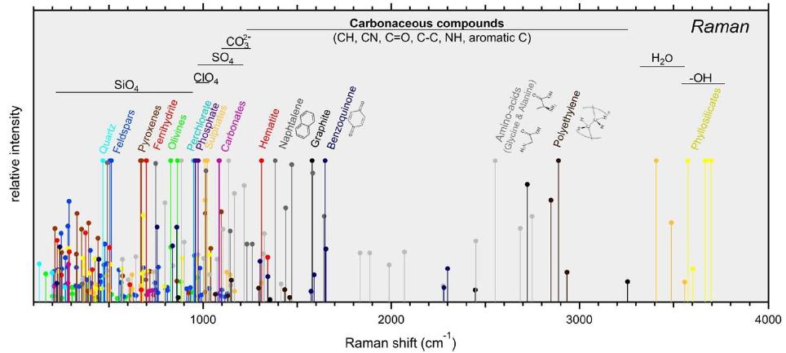
Raman spectroscopy
Typical signatures and vibration modes

Slide 17
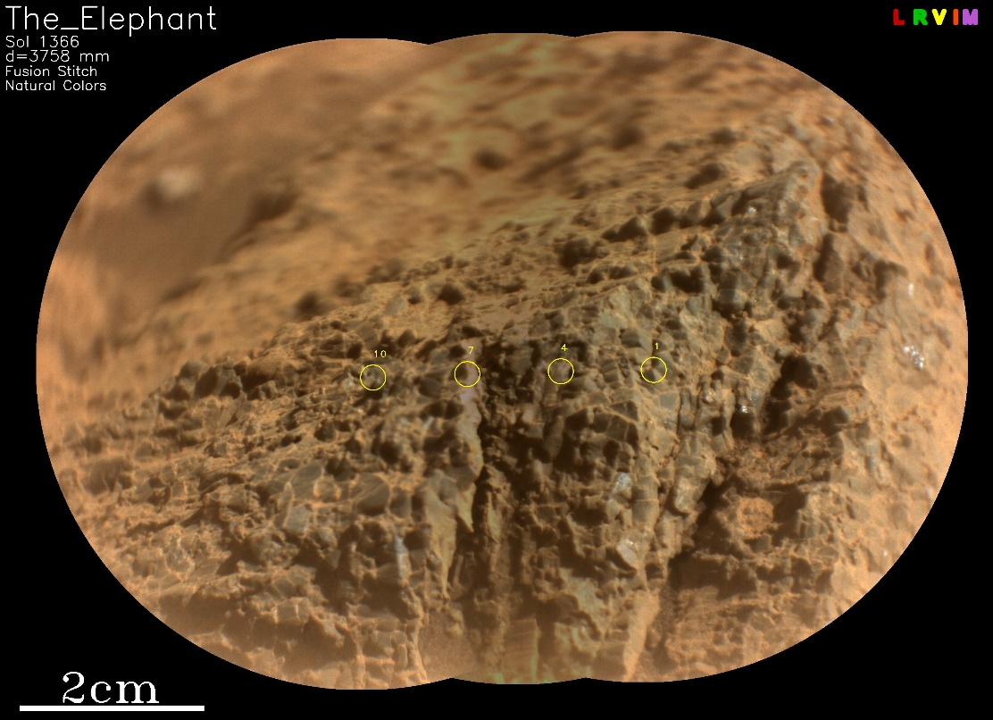
Remote Raman spectroscopy of geological targets
Heterogeneous targets
Variable grain size
Grains often smaller than SuperCam Raman field of view (FOV)
Challenging for strongly absorbing materials
Note: to maximize Raman efficiency, we often acquire spectra on only part of the points analyzed with LIBS and VISIR (typically 1, 4, 7 and 10 for a 10 points raster) and accumulate 400 laser shots on each of these points.
In these examples: nice signals on the coarse, crystalline grains of The_Elephant (pyroxene), and the light toned patch (Na-perchlorate) in the Bellegarde abraded patch; no signal on the small, dark grains of the bulk of Bellegarde.
Notes:
In these xampels: nice signals on the coarse grains of The Elephant, and the light toned patch (Na-perchlorate of Bellegarde); no signal on the small, dark grains of the bulk of Belegarde

Slide 18
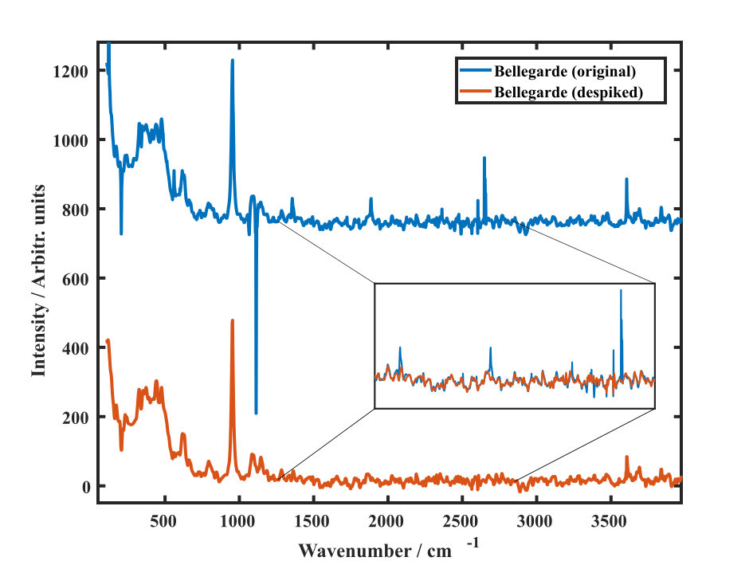
Statistical despiking: checks all individual coadds looking for features outside 2.5 sigma.
Sigma clipping: works on mean spectrum, removes features that are out of the ordinary (kernel=3, sigma=1, maxiter=5) considering the spectral features of the spectrum itself.

Slide 19
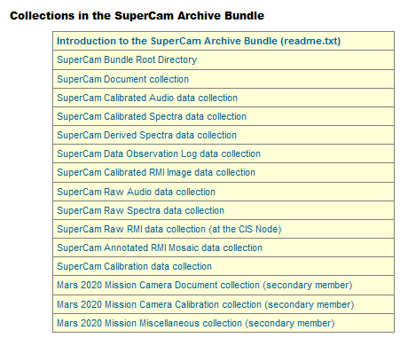
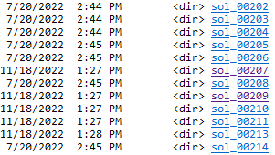
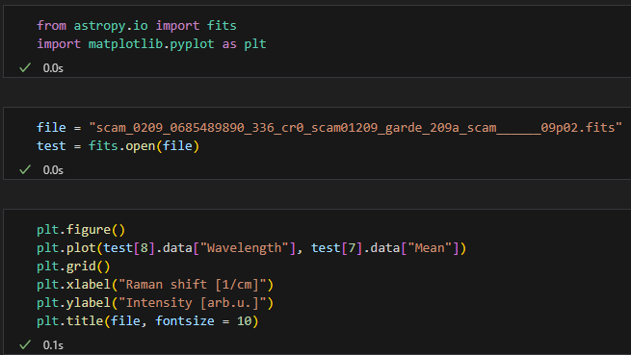
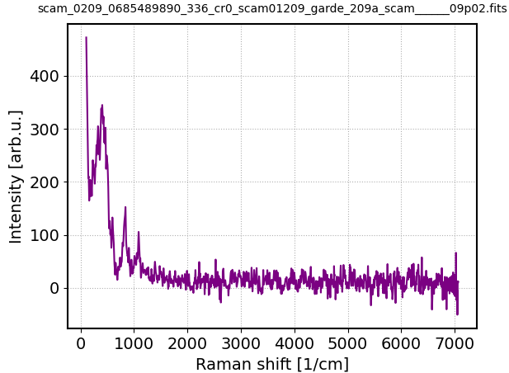
Example: How to get SuperCam Raman data from PDS
1. Select a Raman observation
Overview of observations with identified Raman features. Select those of interest and note the source product (1. column), e.g.:
SCAM_0209_0685489890_336_CR0_scam01209_Garde_209a_scam______09P
This observation was done on sol 209
2. Find the Raman observation
Go to the sol 209 directory
Find the observation corresponding to the previously selected source product
3. Read/plot the Raman observation
Example of Python script on PDS: link

Slide 20
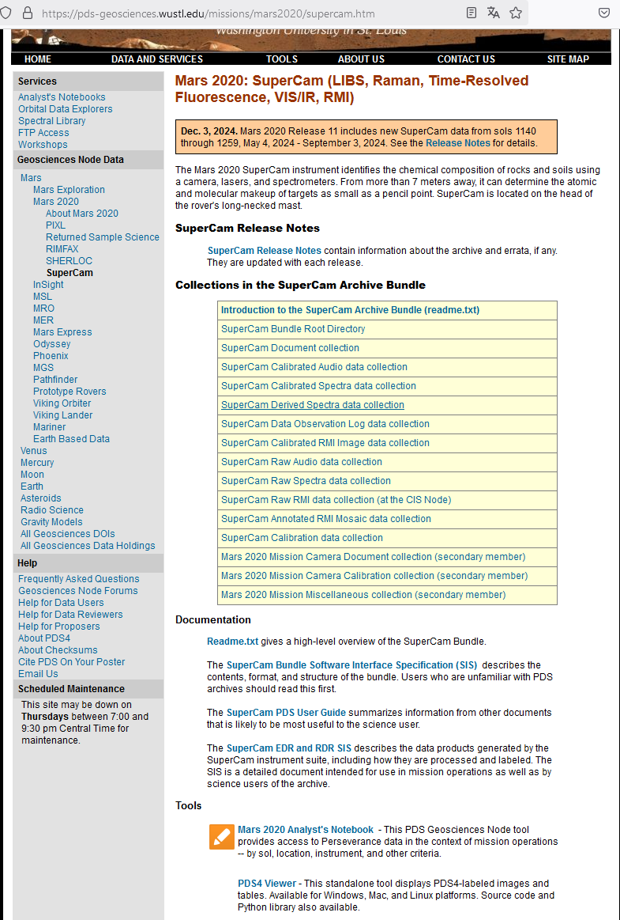
Overview
========
This bundle contains the following collections.
data_raw_spectra: Uncalibrated Laser-Induced Breakdown Spectroscopy (LIBS), Visible and Infrared Passive Spectroscopy (VISIR and IR), Raman Spectroscopy, and Time-Resolved Luminescence Spectroscopy (TRLS)
data products data_raw_rmi: Uncalibrated images from the SuperCam Remote Micro-Imager (RMI)
data_raw_audio: Uncalibrated acoustic recordings from the SuperCam microphone
data_calibrated_spectra: Calibrated LIBS, VISIR, IR, Raman, and TRLS spectra
data_radcal_rmi: Partially radiometrically corrected RMI images
data_calibrated_audio: Calibrated acoustic recordings
data_derived_spectra: LIBS element abundances; VISIR and IR data ratioed to a calibration target; tables of likely and possible mineral identifications from Raman and TRLS spectra
data_special_rmi: RMI mosaics with positions of observations noted; Mastcam images with outlines of RMI images overlaid
data_observation_log: Master spreadsheet of target information document: Descriptions of the SuperCam data products and the archive bundle organization
calibration_supercam: Supercam LIBS calibration data used for MOC

Slide 21
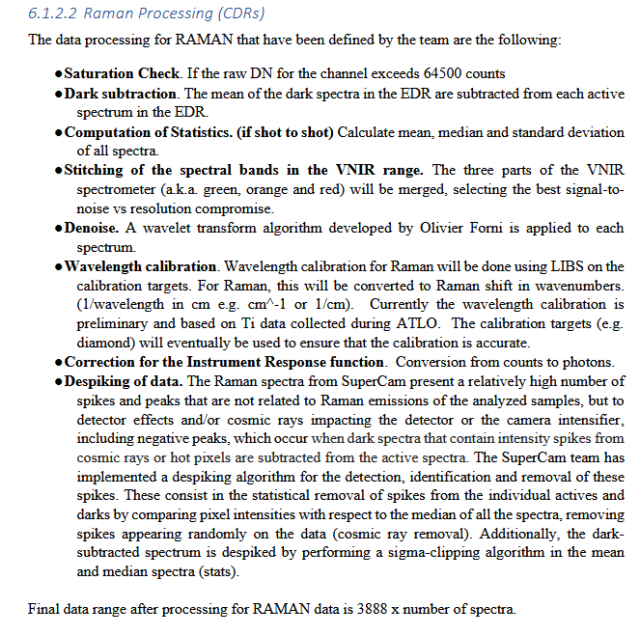
...

Slide 22
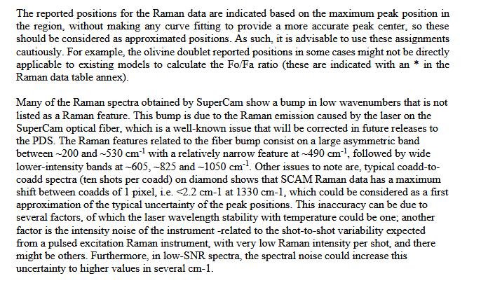
...

Slide 23
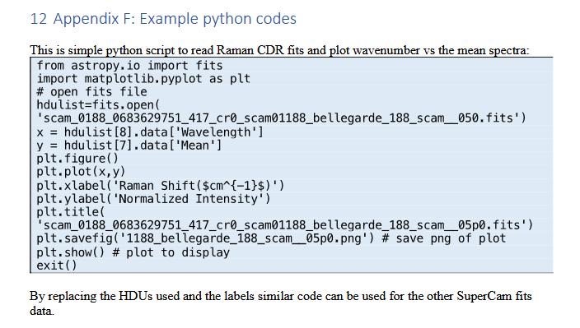

Slide 24
Table listing detected features in the SuperCam Raman and luminescence spectra so far

